Slide 1
A Critical evaluation of the use of the top-down decision making approach, using Navitus Bay Wind Park Development as a case study
Rupert Cope
LLB(Hons), MA(Res) (in progress)
Environment & Threats Strategic Research Group
^{Bournemouth University}

Slide 2
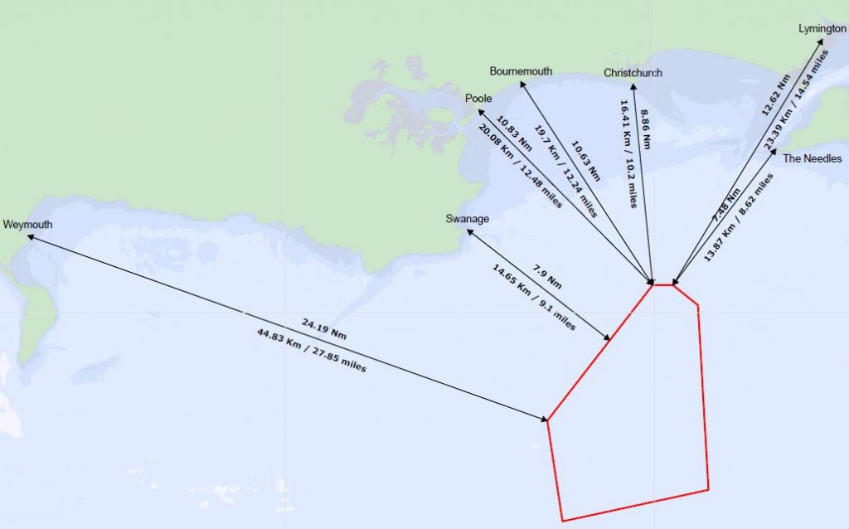
NAVITUS BAY
Offshore wind farm of up to 970 MW of generating capacity from up to 194 wind turbines located off the Dorset coastline, west of the Isle of Wight in the English Channel.
Closest point of the Dorset coast 14.7km & approximately 17km closest point off Isle of White
Under Section 15 Planning Act NB qualifies as a Nationally Significant
Infrastructure Project and as such under S14(3) PA 2008 the Secretary State may grant, amend or reject application for planning permission
11 September 2015 - application for planning permission rejected by the Secretary of State for Energy and Climate Change under S114(1)(b) Planning Act 2008
Notes:
proposed Navitus Bay Wind Farm is an offshore wind farm of up to 970 MW of generating capacity from up to 194 wind turbines located off the Dorset coastline, west of the Isle of Wight in the English Channel.
On 11 September 2015 the Head of National Infrastructure Consents and Coal Liabilities Giles Scott made the decision to reject Navitus Bay Development Limited's application for planning permission to begin construction

Slide 3
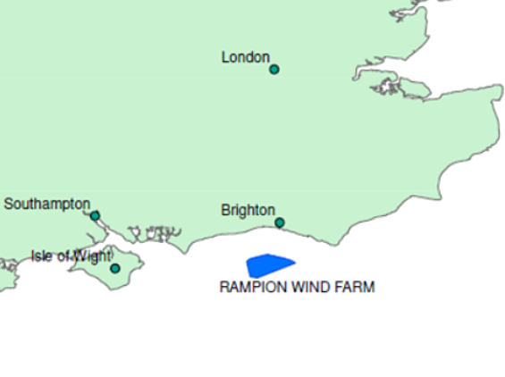
NAVITUS BAY vs RAMPION
^{NAVITUS BAY}
- 194 turbines, 160 km2 total area
- Closest point 14km (before mitigation) from UK coastline
- Local political constituency at time of decision – Conservative
- 4 Rounds of public participation
^{RAMPION OFFSHORE WIND FARM}
- 175 turbines, 72 Km2 total area
- Closest point 13km from UK coastline
- Local political constituency at time of
^{decision – Liberal Democrat}
- 3 Rounds of public consultation

Slide 4
Where did it go wrong?
Examining Authority (ExA)'s Report stated that:
- would comply with the need case set out in the Overarching National Policy Statement for Energy(EN-1)
- Acknowledged presumption in favour of granting developing consent for certain types of NSIP's
- Project likely to lead to creation of 'large number of jobs (up to 1700 full time equivalents)
HOWEVER
- concluded that “the Secretary of State considers…that the development...though not damaging to the protected feature of the World Heritage Site, would adversely affect the use and enjoyment of that site...and it's utility and amenity value”
Navitus Bay viewpoint representation Undercliff Drive, Bournemouth

Slide 5
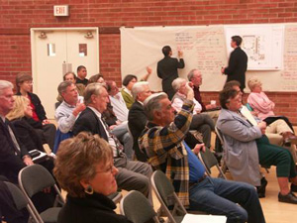
Negative representation during public participation
Large number of locals reacted negatively for fears of potential impacts on property prices

Slide 6
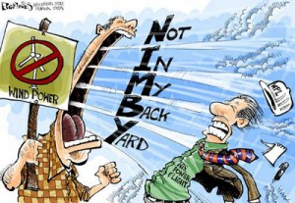
What is NIMBYism?
characterization of opposition by local residents to a proposal for a new development because it is close to their place of residence
Not opposed to general support for offshore wind farms per se, would support construction in different location
Notes:
From an economical standpoint this trend can be identified as the free rider problem, with an individual in a particular community wanting to directly benefit from greater introduction of renewable energy availability whilst avoiding having to figuratively make any form of individual compromise, I.E. by specifically having such a system located near their homes/local area.

Slide 7
Potential causes
Prioritisation for self interest over the need for sustainable generation
Disdain towards policy makers and planners for lack of involvement in decision making
- Top down approach
Insufficient RE knowledge
Consideration for local conditions
Notes:
Prioritisation for self interest
Fear that aesthetic impacts of wind turbines would have a negative impact on property prices located along the coastline
Maarten Wolinsk applies the general NIMBY concept in what is known to economists as game theory whilst identifying a particular opposition to such a provision of a useful and needed public installation as a 'multi-person prisoner dilemma'. Game theory is a model for making decisions that weigh the benefits of a choice along with the interaction of participants in any given scenario. Through analysing relationships whilst trying to predict the move that the other(s) will make, a person(A) will shape their own actions to help guide the other(s)(B) decision making to achieve an outcome which is the most advantageous for them(A) personally; for example like in a game of chess.
Distain towards policy makers...
As defined by Section 15 of the Planning Act 2008, Navitus Bay comes under definition as a 'Nationally Significant Infrastructure Project' and as such the Secretary of State may under S14(3) grant, amend or reject an application of planning consent. Therefore the direction of the influence and information on decision-making is considered to be top-down, i.e. from central Government flowing downwards to the local community.
- therefore restricting valuable interaction between policy makers and planners with the local individuals could lead to a lack of knowledge for that specific project, which would then allow frustration and hostility grow within the local community towards those attempting to implement the project in question.

Slide 8
Problems flow from Central Government??
1) Lack of precise definition
- despite AC Article 2 providing definitions of what PP is and Article 6(7) stating the elements of PP, there has been no transfer of any express definition of how to conduct such within UK law
4) Incompatibility between national and local planning objectives
Locals E.g. Concern for house prices, Local tourism and businesses and protection of local amenities
National policy makers concerned with achieving national obligations under RED 2009, speed of decisions
5) Lack of clarity of core concepts - It is the legal decisions of the
courts themselves which convert planning concepts in legislation from contestable to determinate, HOWEVER courts demonstrate unwillingness to do so eg. presumption in favour of SD - Mr Justice Collins in Scrivens v. Secretary of State for Communities and Local Government
6) Policy makers' misconceptions of local participation
- Bottom/up participation
- 'Deficit model' – lay people ignorant of technical issues
2) Planning Act 2008 – centralised NSIP decisions from local councils with introduction of the Infrastructure and Planning Commission, also in attempt to speed up process of decisions, restricted opportunity for public to make representations
3) Localism Act 2011 – Introduced as the 'essential guide' for local communities to 'do things their way', however merely transferred the examination of applications for development consent to a new Infrastructure Planning Unit within the Planning Inspectorate
Notes:
1) Only the Aarhus Convention Article 6(7 ) states the elements of participation: “Procedures for PP shall allow the public to submit in writing or, as appropriate, at a public hearing or inquiry with the applicant, any comments, information, analyses or opinions that it considers relevant to the proposed activity.”
- Article 5, paragraph 5, is to be implemented “within the framework of [a Party’s] legislation”, giving Parties some flexibility in implementing measures that both meet the Convention’s obligations and can be placed within the national legal framework.
2) Despite Government sounding within it's 'Essential Guide' for the need for empowering local communities 'to do things their way' prior to the Localism Act coming into force in 15 November 2011, it abolished the Infrastructure and Planning Commission and transferred the examination of applications for development consent to a new Infrastructure Planning Unit within the Planning Inspectorate, keeping said powers within centralised governmental departments under the Department for Communities and Local Government (DCLG). This highlights the problem that if a particular planning proposal is affecting a specific local area yet the final decision is being made by a centralised government department, what makes that decision a 'local' one?
3) Lees and Shepherd illustrate that 'the key factor that tips the balance is the presumption in favour of sustainable development', however they demonstrate that the courts are unwilling to expressly define what that particular presumption is and would simply rather refer to the National Planning Policy Framework as a whole, despite the fact that each local community would have it's own specific characteristics combined with certain standard of local knowledge of such a particular community embedded within it. Mr Justice Collins in Scrivens v. Secretary of State for Communities and Local Government when called upon to provide such a definition, replied: “I do not think that it is desirable that I should attempt to do that. What is sustainable in any particular circumstance will depend on a number of material factors.”
4) A presumption among policy makers identified as a 'deficit model', assumes that lay people to be somewhat ignorant towards technological issues and to be unable to adequately engage with policies involving new technologies, whilst viewing protesters to renewable projects as emotional individuals capable of ultimately influencing outcomes which should solely be based on 'rational' decisions through which facts should predominate

Slide 9
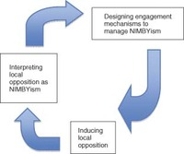
Devine – Wright's 'Cycle of NIMBYism'

Slide 10
Personal Investment before Locality
Article 2 para 4 of AC: “the public affected or likely to be affected by, or having an interest in, the environmental decision-making; for the purposes of this definition, non-governmental organizations promoting environmental protection and meeting any requirements under national law shall be deemed to have an interest.”
Town and Country Planning (Development Management Procedure) (England) Order 2010 (DMPO 2010) requires an applicant for planning permission to give notice to the landowner to which the application relates
- Landlords not Tenants
- excluding those who would under AC have genuine interest
BRIGHTON AND HOVE
% of households owner occupied 53%
% of households public rented 15%
% of households privately rented 28%
DORSET
% of households owner occupied 73%
% of households public rented 12%
% of households privately rented 14%
Notes:
Expanding on academic belief that locals are more likely to hold NIMBYistic viewpoint due to locality.
As no definition within UK law as to definition of who is a member of the 'public concerned', locality is the logical base test of who may/not be granted representation in PP.
However, after a vast number of those representations made by local individuals were against plan because of perceived negative impact on property via potential aesthetic impacts

Slide 11
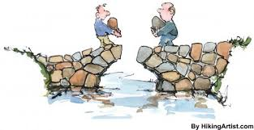
Paradigm Shift
Planners need to identify and address specific needs of a particular community
Local individuals need to regain trust in planners
Policy makers need to identify, address and involve ALL members of society

Slide 12
Potential remedies
Greater need for more involvement of local individuals throughout various stages of planning and construction processes
Inter-generational Participation
Educational level
- increased information on global warming and renewable energy from environmental, business and engineering perspectives
- Apprenticeship schemes
Employment level
- Offer of % of jobs to locals
- construction, operations & maintenance
- promotional / public participation
- business
Fiscal level
- compensation schemes
- co - ownership schemes
- Community benefit schemes
- % reduced/free power to help disadvantaged households that could also help combat fuel poverty
Notes:
From a local perspective, if offered to lesser affluent households within a community e.g. those relying on state benefits to combat self fulfilling prophecy of perception that are the excluded within that community, provide belonging

