Slide 1
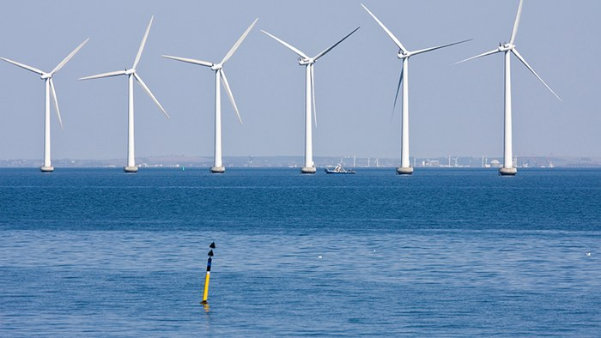

PUBLIC PARTICIPATION in the development of off-shore wind farms

Slide 2

Birgitte Egelund Olsen
AARHUS UNIVERSITY
School of Business and Social Sciences
Department of Law
M: beo@law.au.dk
Professor Ph.d. LL.M.
Head of Section
Research & External Funding
Director of Study
Master of Environmental & Energy Law
Vice Chairman
Energy Board of Appeal
Chairman
Wind Turbine Valuation Authority
Legal Expert
The Baltic Integrid: Integrated offshore wind electricity grid development, EU Interreg Baltic Sea
au.dk

Slide 3
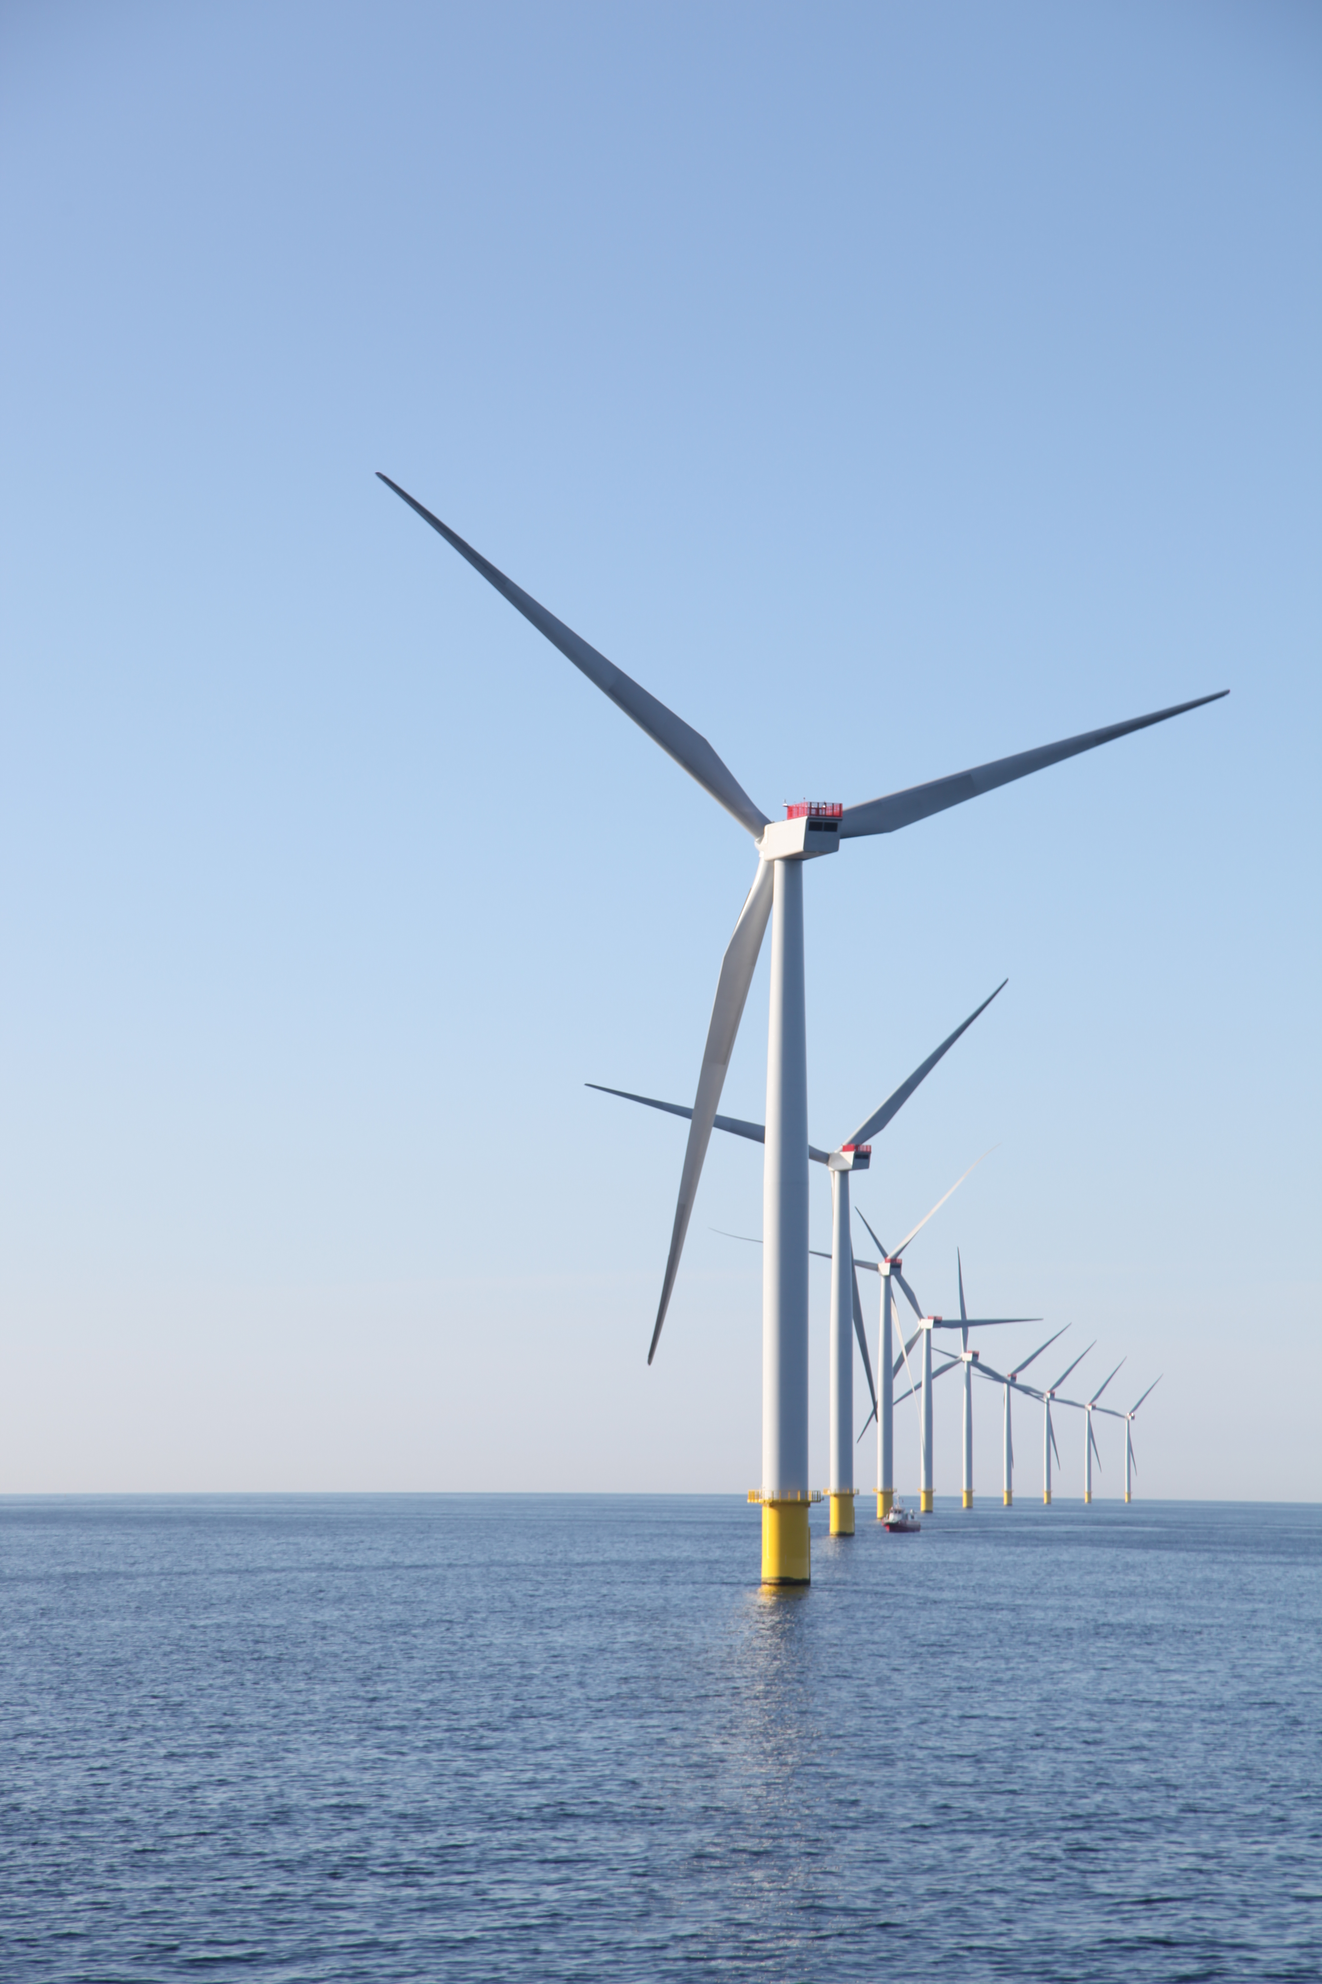
Outline
      Mapping the public interest in offshore wind projects
      Legal framework for public participation
      An integrated legal framework for planning and permitting
      Linking public participation and acceptance
      Concluding remarks
pensiondanmark.com

Slide 4

Mapping the interest of the public to take part in the project planning

Slide 5
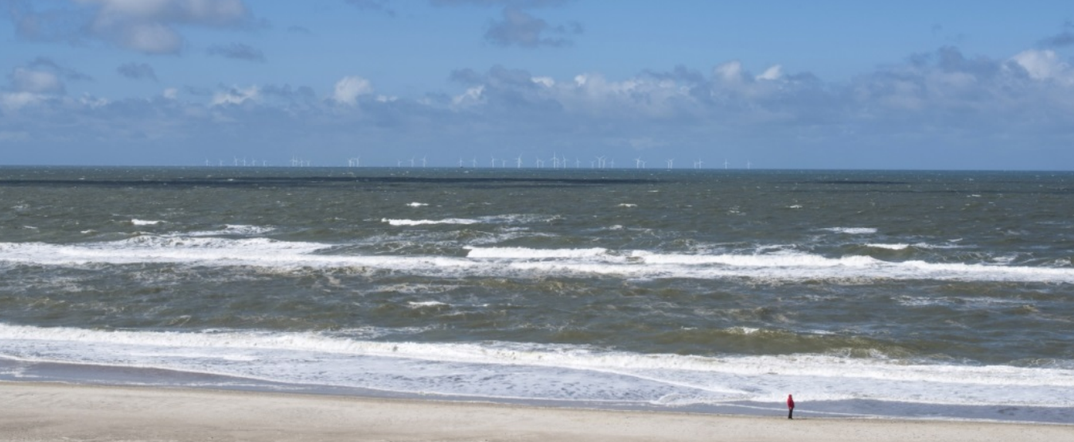
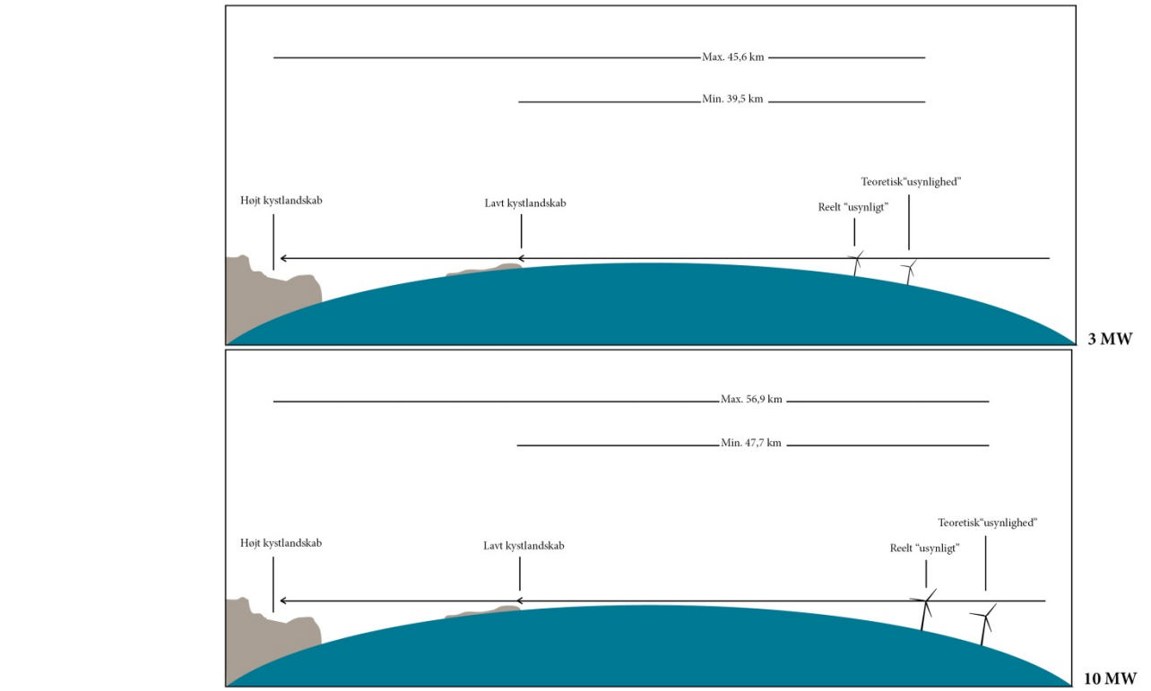
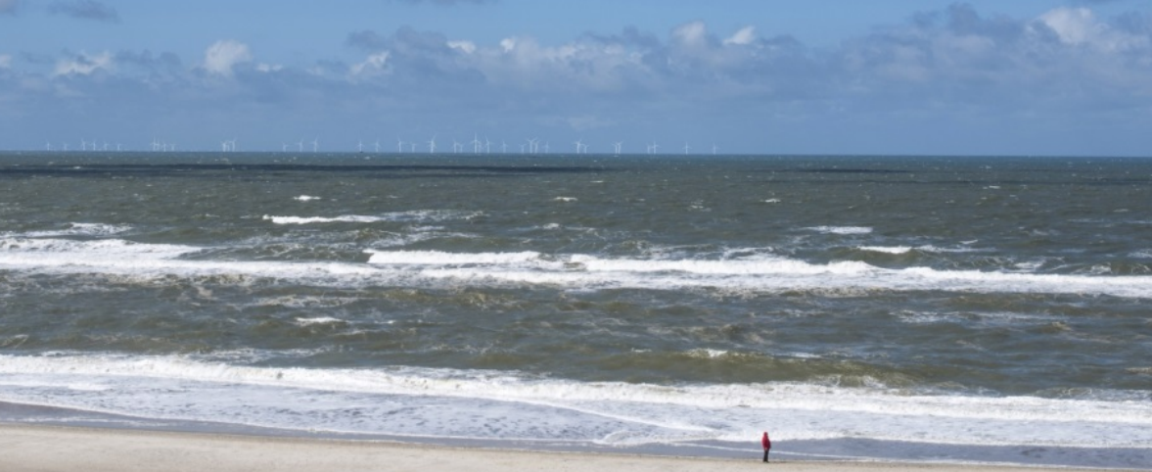
Windparks Horns Rev II & III From Nymindegab
Distance approx. 40 km
Energinet.dk & Orbicon A/S

Slide 6
Jammerland Bay Project
From Røsnæs Havn distance 4.3 km
20 x 10 MW
66 x 3 MW
0-Alternative: Non-implementation of the coastal wind project
PlanEnergi

Slide 7
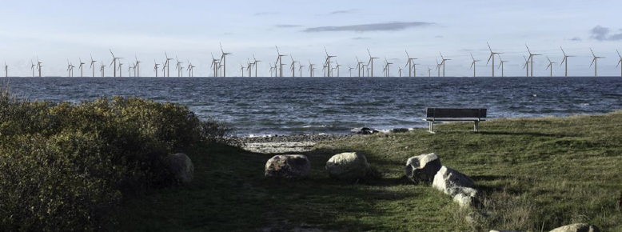
Community perception …

Slide 8
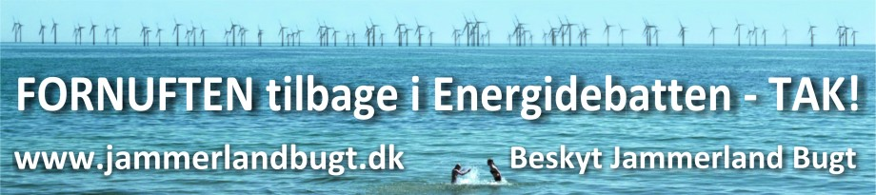
Or like this…

Slide 9
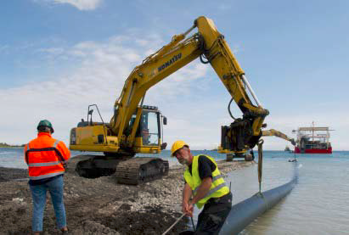
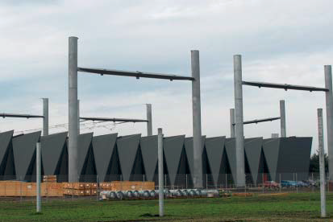

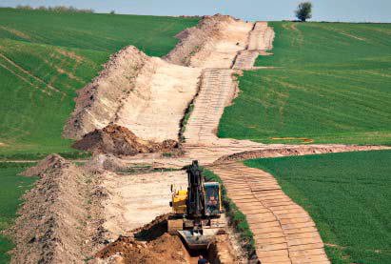
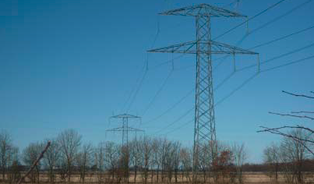
ONSHORE INFRASTRUCTURE

Slide 10
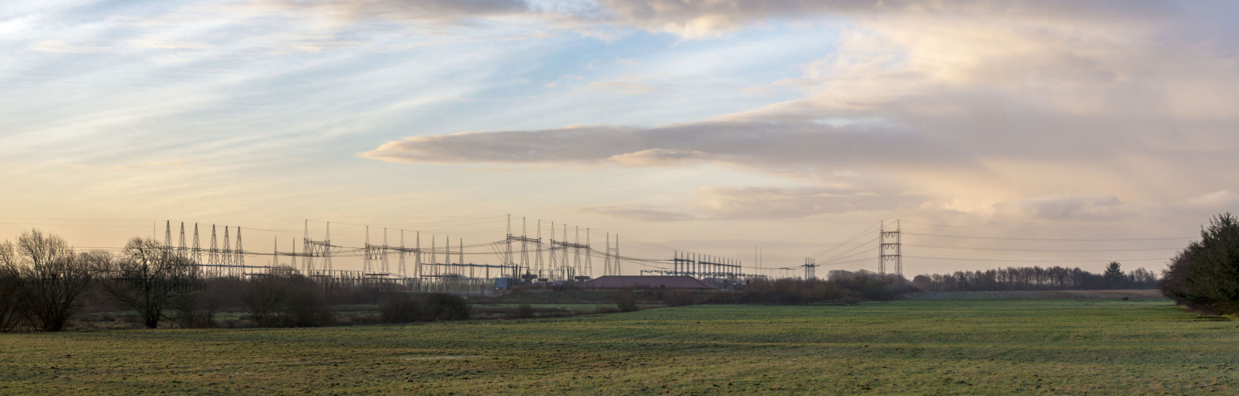
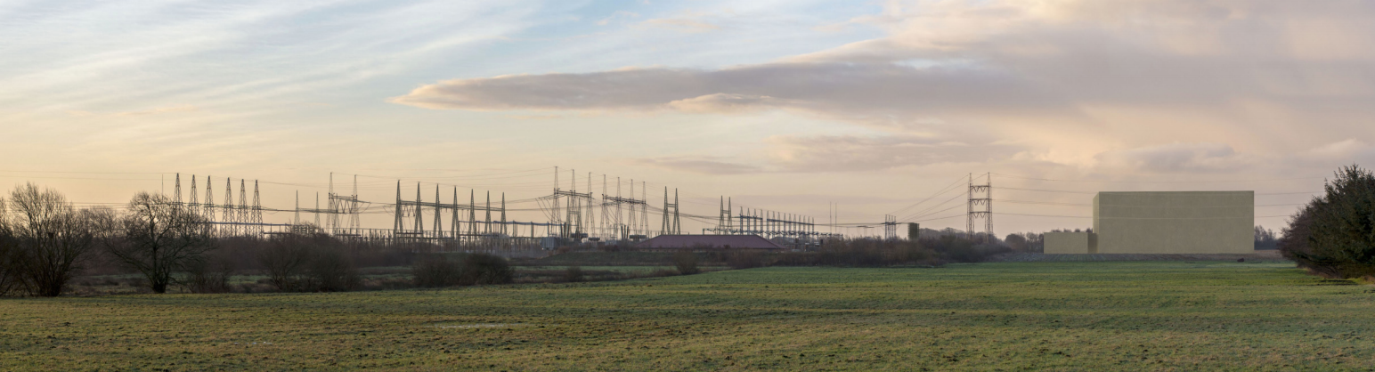
ONSHORE INFRASTRUCTURE
Impact

Slide 11
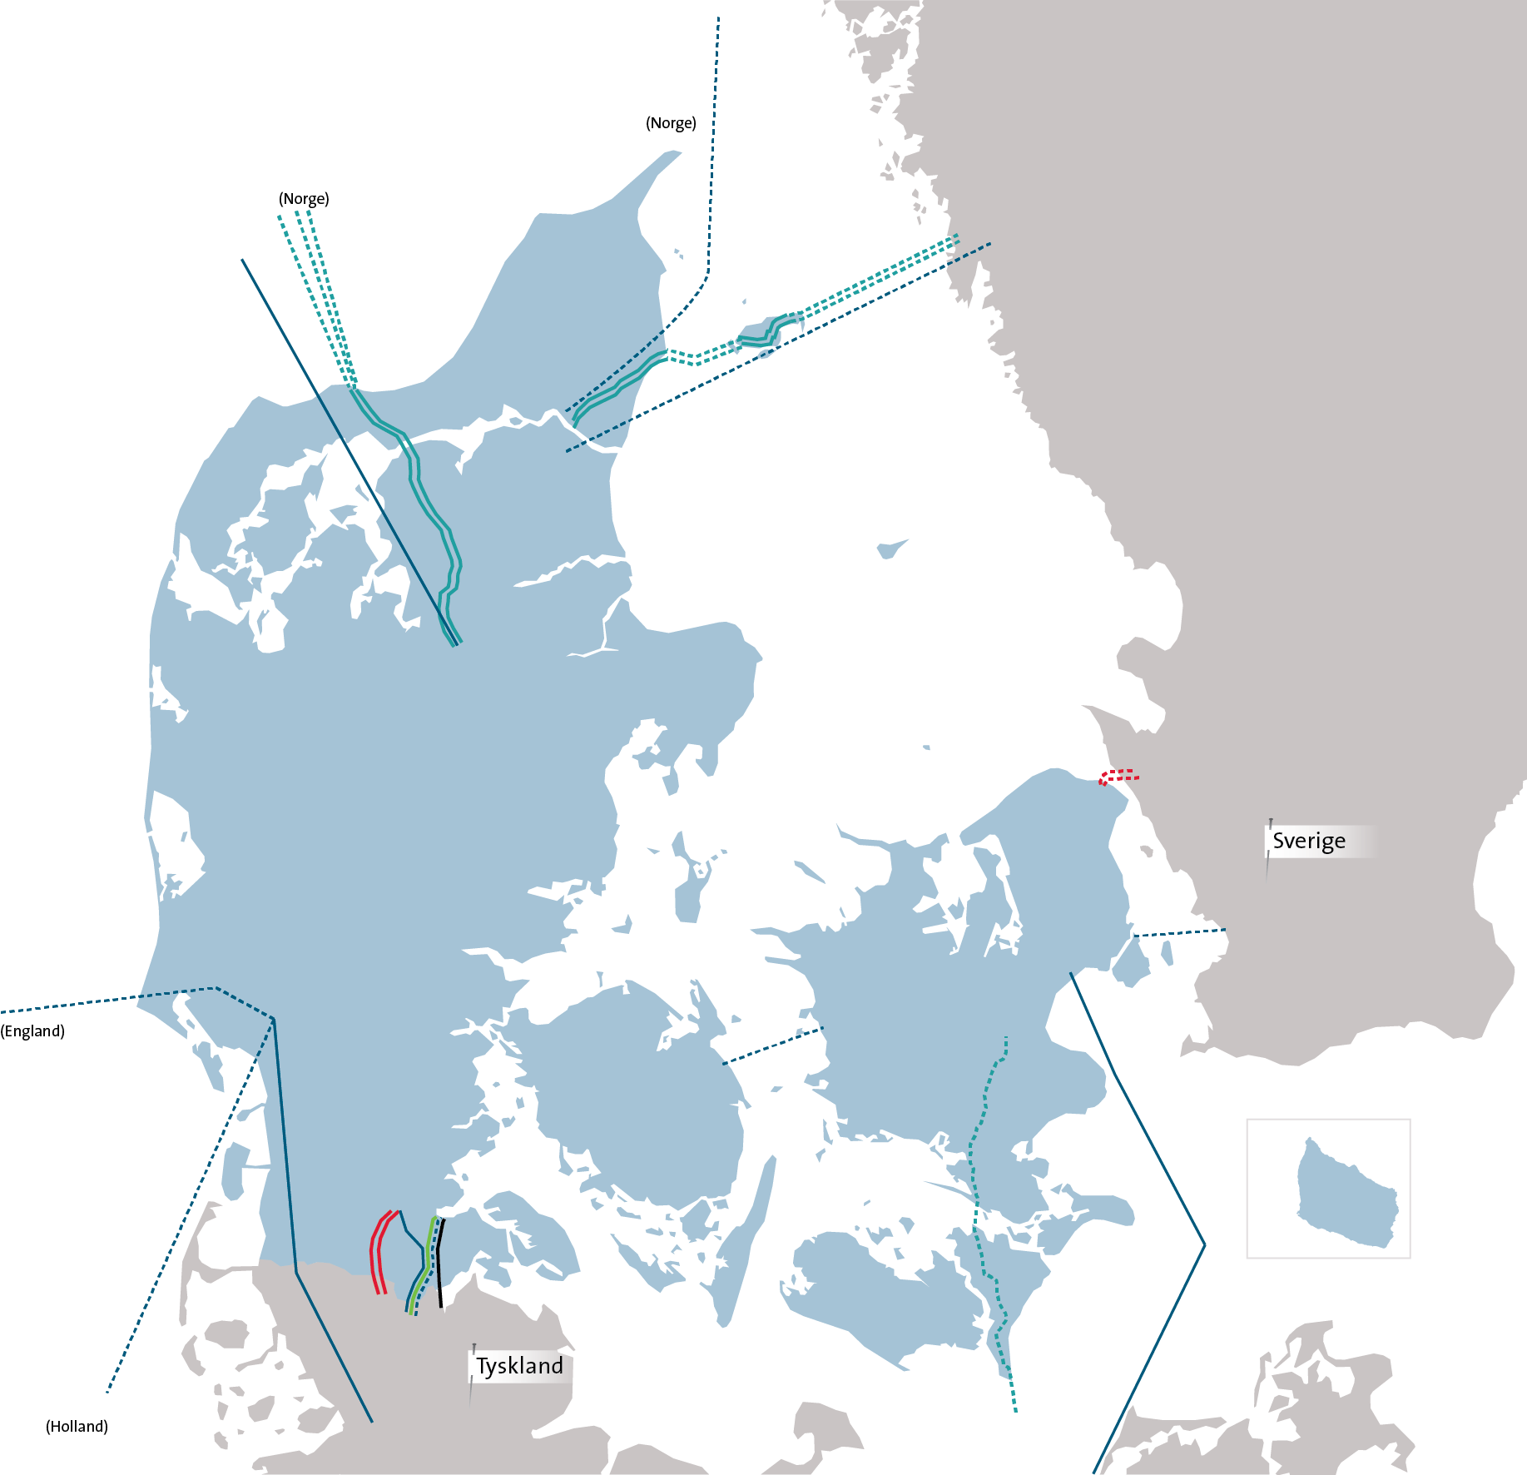



The onshore and offshore infrastructures of an offshore wind farm do not necessarily affect the same group of people
Energinet.dk

Slide 12
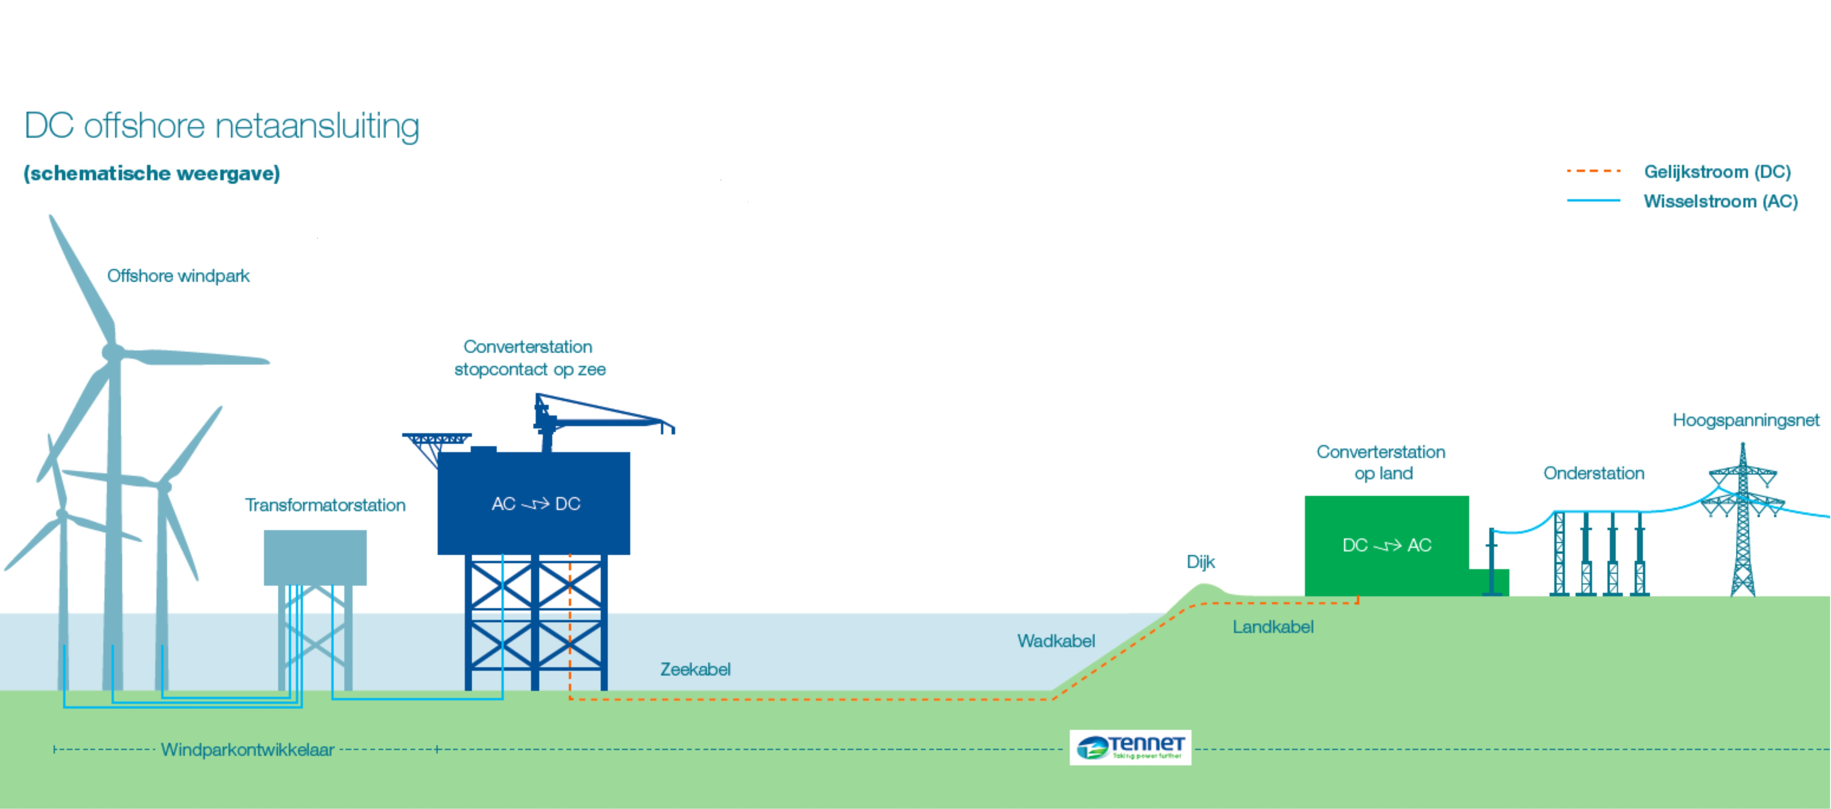
OFFSHORE
ONSHORE

Slide 13

Legal Framework for public participation
Onshore
Important distinctions, e.g.:
    Subject to a TENDER procedure within a designated area or an ‘OPEN DOOR’ procedure outside designated areas
    Large scale OFFSHORE wind farm or COASTAL – near-shore – wind farm
  Offshore or ONSHORE infrastructure
Tender
Open door
Offshore
Coastal

Slide 14

The Danish Legal Framework for public participation
 | Offshore – ‘Open door’ | Offshore - Tender | Onshore infrastructure
Authority | Energy Agency |  | Municipalities/Nature Agency
Legislation | Renewable Energy Act |  | Planning Act
Strategic planning | ~ | No formal requirement SEA | Obligation SEA
Project planning/ preliminary investigations | Screening and scoping EIAs Natura 2000 |  | Screening and scoping Pre-consultation EIAs Natura 2000
 | Establishment permit |  | EIA permit

Slide 15
an integrated planning and permitting process

Slide 16
An integrated process – Horns Rev III
Competent authorities:
Energy Agency (Offshore EIA and permit)
Nature Agency (Municipal planning, onshore SEA and EIA)
3 municipalities: Varde, Esbjerg and Vejen (Local plans)
Developer: TSO (Energinet.dk)
Main infrastructure elements:
The offshore wind park
Offshore transformer platform
Submarine cables
Onshore transformer stations
Land cables
Wire systems
Joint pre-consultation and public meetings
Joint SEA and EIS
Joint con-sultation
Establish-ment permit
EIA permit
Joint screening and scoping

Slide 17
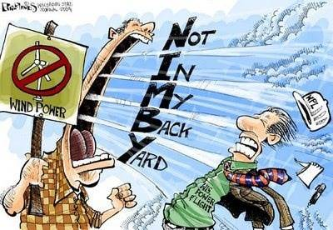
Additional Public Participation measures
How to involve the public or accommodate lack of public acceptance of offshore wind projects

Slide 18
Technical adjustments, information, economic development …
Examples:
Additional landscape works and screening to mitigate views of infrastructure
Increase setbacks or reduce number and height
Education and information campaigns
Visiting centers, boat trips
Local development, local jobs
...

Slide 19
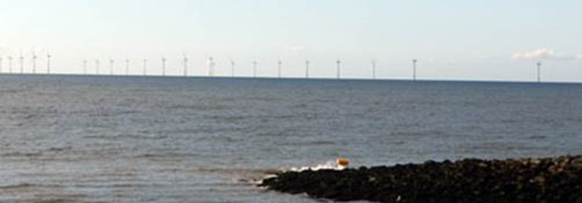
Local Acceptance Toolbox
Onshore
Compensation scheme
Co-ownership scheme
Tender
Open door
Offshore
Coastal

Slide 20
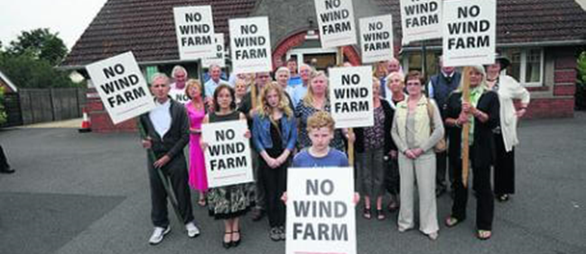
Compensation for loss of value to dwellings (RE Act Sec. 6-12)
Imposes an obligation to compensate neighbors for loss of value to their dwellings
  ≥1% then full compensation
  The duty of the developer to pay the compensation (and administrative expenses)
  Does the compensation scheme lead to an increased acceptance?
  No offshore experience yet!
  May be difficult to make workable in practice!
  Onshore wind experience with the compensation scheme
  Immense difficulties of adapting expectations
  An increased focus on the nuisance

Slide 21
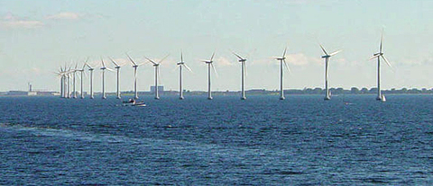
Local citizens’ option to purchase wind turbine shares
The co-ownership scheme imposes an obligation on all new wind energy projects to offer a minimum of 20 percent ownership to local citizens (only private individuals)
Covers citizens with a permanent residence in municipalities with a coast line within 16 km from the nearest turbine
  Additional incentive: If at least 30% of the project is locally owned the wind project will receive an extra price supplement (DKK 0.01/kWh)
  Does the compensation scheme lead to an increased acceptance?
    No offshore experience yet!

Slide 22
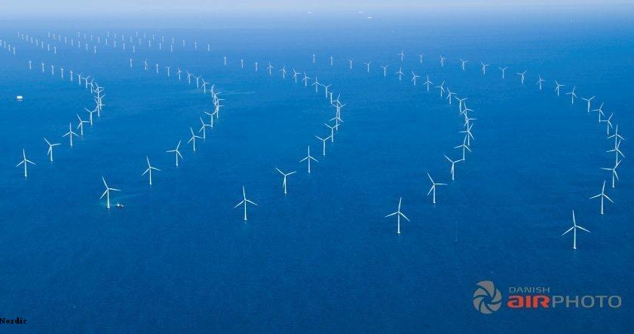
Public participation and offshore wind
A ‘beginners tool box’:
A ‘prototype’ integrated offshore and onshore planning and permitting process
Earlier, concurrent and broader citizen participation
  One-stop-shop/lead authority?
  An integrated strategic planning process?
Public acceptance measures … revised?

Slide 23
