Slide 1
Environmental Rule of Law – a Panacea for Procedural Environmental Rights
Loretta Feris
Institute of Marine and Environmental Law, University of Cape Town, South Africa

Slide 2
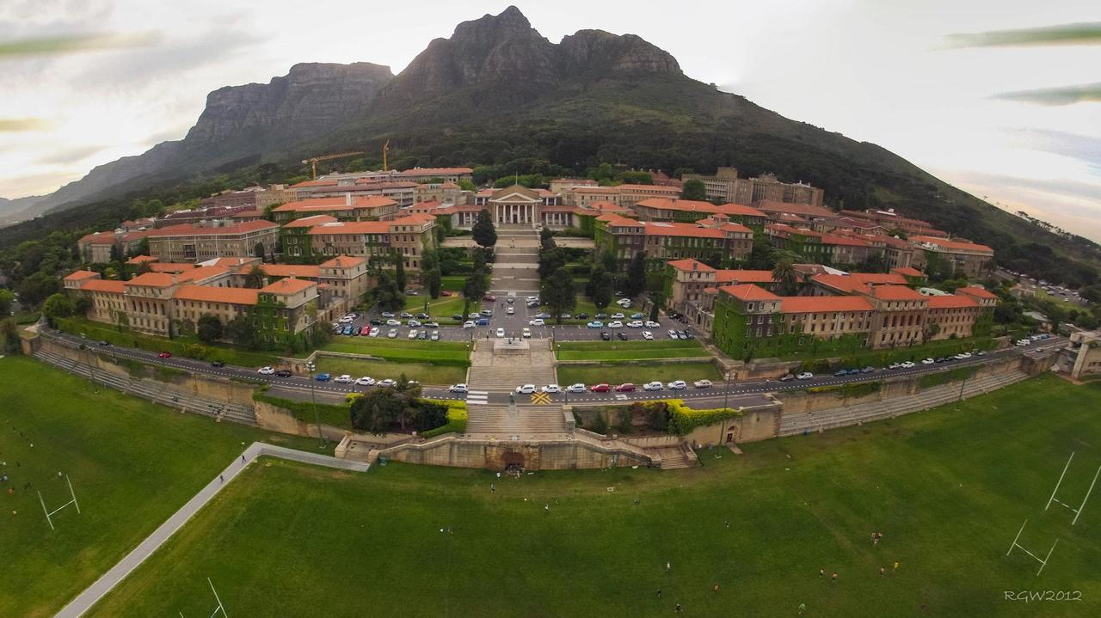

Slide 3
PERs under threat
Central-right politics and the retreat from environmental guarantees
Pressure on governments to remove “stumbling blocks” to development
Effectiveness?
Narrow application of PERs

Slide 4

Is ERL a panacea?

Slide 5
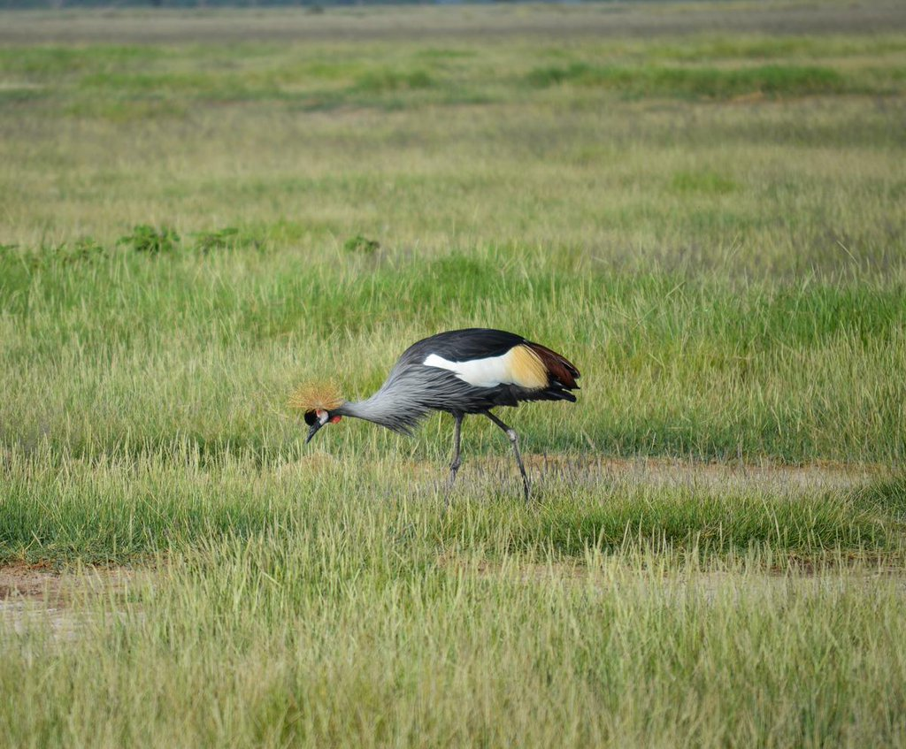
What is ERL?

Slide 6
The beginning
World Congress on Justice, Governance and Law for Environmental Sustainability organised by UNEP prior to the Rio+20 Conference
First official use in 2013: 27th Session of the UNEP Government Council/Global Ministerial Environment Forum – call on UNEP to lead UN and governments:
Development and implementation of environmental rule of law with attention at all levels to mutually supporting governance features, including information disclosure, public participation, implementable and enforceable laws, and implementation and accountability mechanisms including coordination of roles as well as environmental auditing and criminal, civil and administrative enforcement with timely, impartial and independent dispute resolution.

Slide 7
Emergence of ERL
27th Session of the UNEP Government Council/Global Ministerial Environment Forum – UNEA
Regional endorsement:
  November 2013: Asia and Pacific colloquium on ERL
  March 2015: Inter-American Congress on the Environmental Rule of Law
  October 2015: Africa Colloquium on Environmental Rule of Law
Global endorsement:
  Global Symposium on Environmental Rule of Law – first session of UNEA in June 2014
  World Congress on Environmental Law in April 2016

Slide 8
2013: Putraya Statement
Constituent elements of ERL:
  Adequate and implementable laws
  Access to justice and information
  Public participation
  Accountability
  Transparency
  Liability for environmental damage
  Fair and just enforcement, and
  Human rights

Slide 9
2015: Nairobi Statement
Constituent elements of ERL:
  Information disclosure
  Public participation
  Implementable and enforceable laws
  Implementation and accountability mechanisms, including coordination of roles
  Environmental auditing and
  Criminal, civil and administrative enforcement with timely, impartial and independent dispute resolution

Slide 10
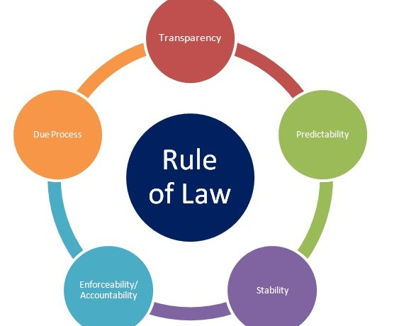
Is it not simply rule of law?

Slide 11
April 2016: World Declaration on the Environmental Rule of Law
Principle 1 Responsibility to Protect Nature
Principle 2 Right to Nature
Principle 3 In dubio pro natura
Principle 4 Ecological sustainability and resilience
Principle 5 Intragenerational equity
Principle 6 Intergenerational equity
Principle 8 Participation of minority and vulnerable groups
Principle 9 Indigenous and tribal peoples rights
Principle 10 Non-regression
Principle 11 Progression

Slide 12
World Declaration on the Environmental Rule of Law
Principle 3 In dubio pro natura
Principle 10 Non-regression
Principle 11 Progression

Slide 13
In dubio pro natura
Precautionary principle?
Scientific certainty
In cases of doubt, matters shall be resolved in a way most likely to favour the protection and conservation of the environment. Preference shall be given to alternatives that are least harmful to the environment.
Actions shall not be undertaken when their potential adverse impacts on the environment are disproportionate or excessive in relation to the benefits derived therefrom.
Legal certainty

Slide 14
Non-regression
Prevents public authorities from modifying or abolishing existing legislations if doing so would diminish the protection of the environment (Prieur)
Purpose of environmental law aims to not only regulate the environment but also to prevent its degradation
It is in the interest of future generations to make an exception to the rule that legislators can always change the law
States must constantly strive to enhance the protection of the right to a healthy environment.

Slide 15
Progression
Requires States, sub-national entities and regional integration organisations to progressively revise and enhance laws and policies related to environmental conservation and protection on a regular basis, based on the most recent scientific knowledge and policy developments.
Progression - corollary to non-regression: speaks to the need for progress in environmental law to ensure that the needs of future generations will be met
Positive obligation to enhance and strengthen environmental laws, including PERs

Slide 16
The way forward
ERL – a concept worth pursuing?
Further elaboration and conceptualisation
Role vis-à-vis other existing principles of EL
Status beyond UNEA

Slide 17
April 2016: World Declaration on the Environmental Rule of Law
Principle 1 Responsibility to Protect Nature
Principle 2 Right to Nature
Principle 3 In dubio pro natura
Principle 4 Ecological sustainability and resilience
Principle 5 Intragenerational equity
Principle 6 Intergenerational equity
Principle 8 Participation of minority and vulnerable groups
Principle 9 Indigenous and tribal peoples rights
Principle 10 Non-regression
Principle 11 Progression

Slide 18


