Slide 1
Access to Environmental Justice in India: Innovation and Change
Dr Gitanjali N Gill
Northumbria Law School
Northumbria University UK

Slide 2
INDIA
Population
1.32 billion people
Projected- 2030 [1.53 billion] &
2050 [1.80 billion]
Economic growth-7.5 percent
Pressure on the environment and natural resources
Two issues- specialised forum (green courts) and standing (locus standi)

Slide 3
INDIA- ENVIRONMENTAL JUSTICE DISCOURSE [PEOPLE CENTRIC]
Public Interest Litigation [PIL]
Polycentric, conflict resolving tool- people- oriented approach, judge fashioned remedies
Advantages- speedy, inexpensive and direct access to highest court
Constitution- locking human rights and environment through PIL; a new ‘environmental jurisprudence’
Right to life [Article 21]
Access- Representative and Citizen Standing

Slide 4
PIL- Constraints
PIL- innovative and powerful tool to protect human rights known in civilised society- a ‘magic bullet’?
Problems-
activism v constraint debate;
judges not trained in complex environmental issues;
contradictory scientific and technical reports;
time and costly litigation

Slide 5
Specialised Judicial Forum- National Green Tribunal
National Green Tribunal (NGT)
In-house expertise- judicial and scientific
Access to justice- Three points
Aggrieved person- liberal interpretation
Two reasons for a liberal interpretation
the inability of persons living in the vicinity of proposed projects to understand the scientific detail, coupled with the effects of the ultimate project and any disaster it may cause
the constitutional mandate of Article 51A(g) establishes a fundamental duty of every citizen to protect and improve the natural environment
Court cost and time- £10; 6 months

Slide 6
NGT- New Procedures
Develop its own procedures
Suo motu
Investigative procedure
Stakeholder consultative procedure
Major issues- air or water pollution
Larger interest of the society- public health and environment
Greater element of consent

Slide 7
Air Pollution- Consultative

Slide 8
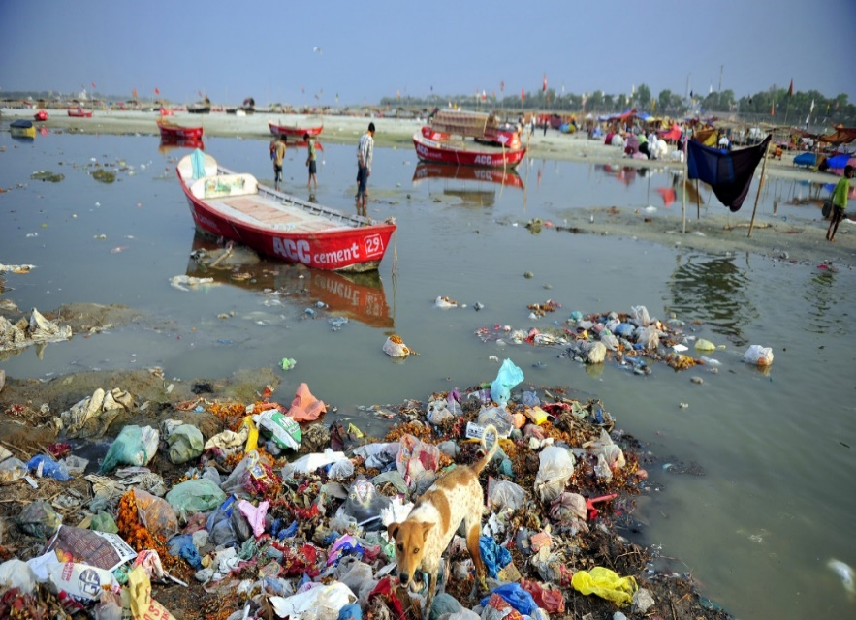
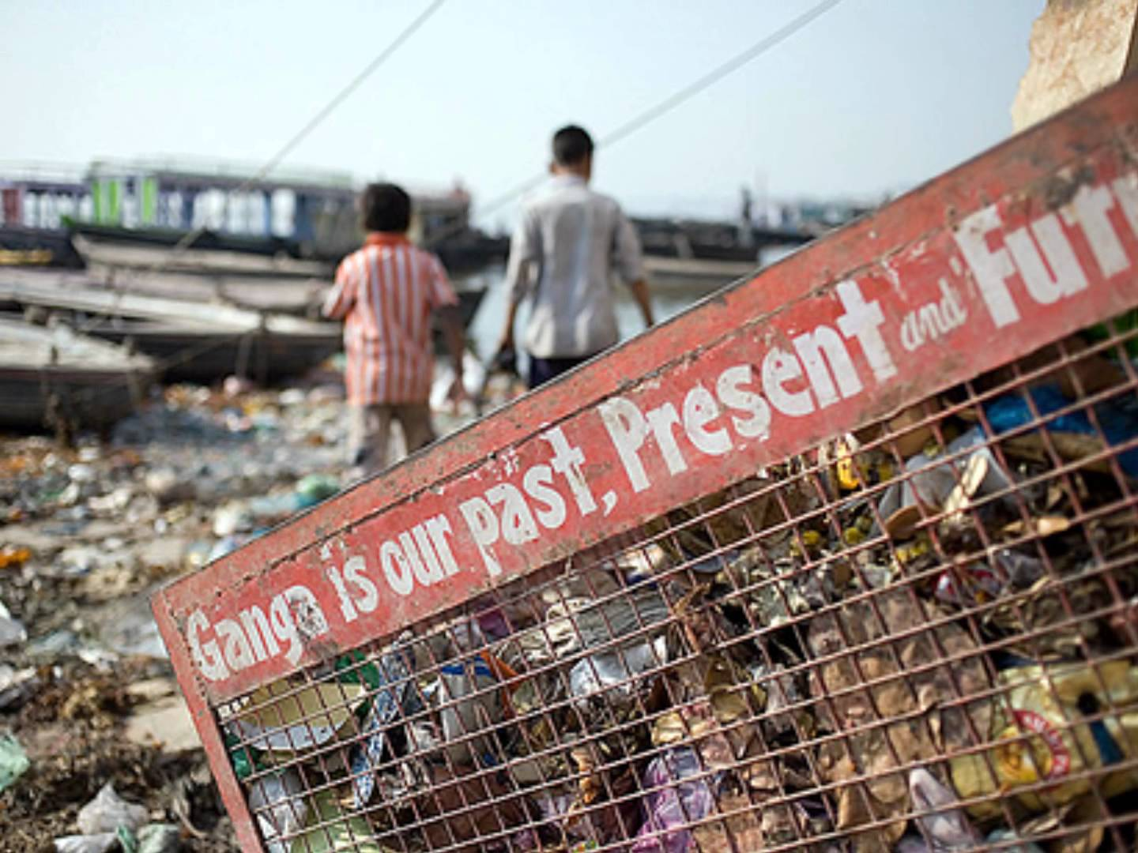
Ganges Pollution- Consultative

Slide 9
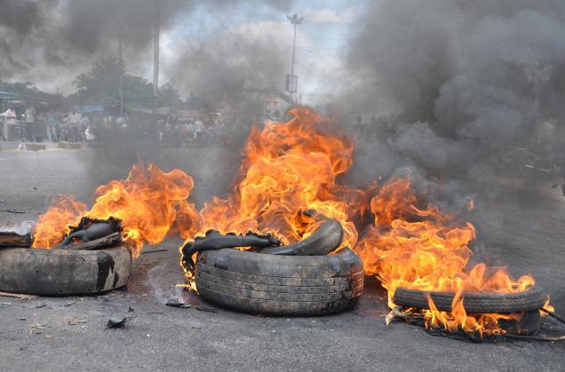
NGT- Prescriptive Policies/Rules
Prescriptive policies/rules
Used tyres disposal- Asim Sarode v Maharashtra Pollution Control Board (2014)

Slide 10
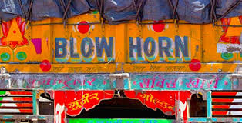
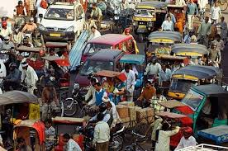
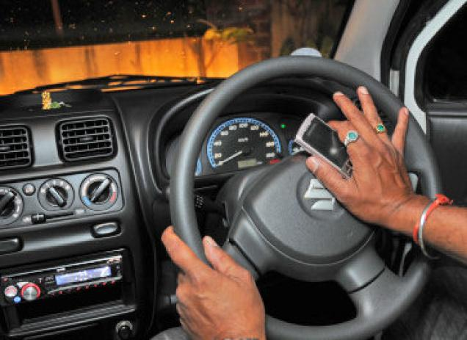
NGT- Prescriptive Policies/Rules
Noise – D.B.Nevatia v Union of India (2013)

Slide 11
Conclusion
India’s judiciary- progressive and dynamic
Expansive- constitution
Standing/aggrieved- liberal
NGT- decides cases AND creates policy [traditional, extra traditional roles]
Good governance and environmental democracy

Slide 12
Thank You

