Slide 1
The EU‘s ‚participatory‘ authorisation process for GMOs
between aspiration and reality

Slide 2
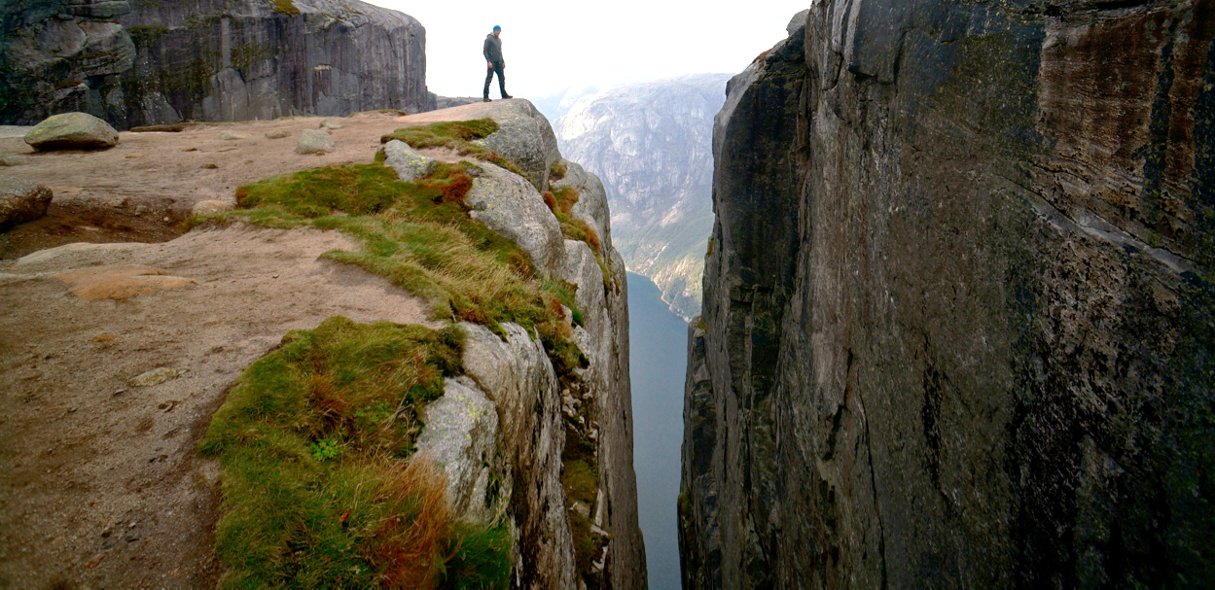
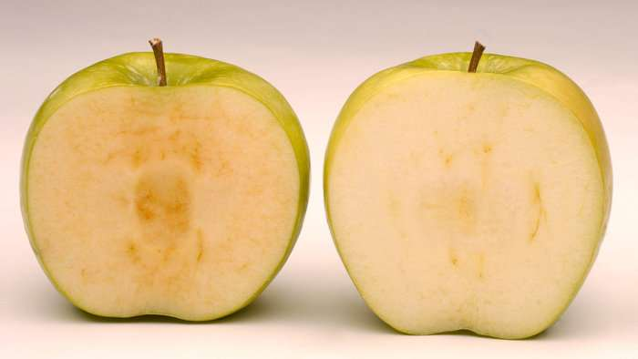
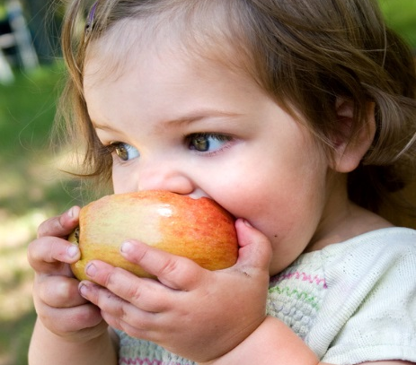
Genetically modified organisms: The gist of the matter?
…enormous market potential
for some
…cause for concern
for others

Slide 3
Principle X as appropriate response: GMO amendment to the Aarhus Convention
Applying Principle X to create trust in GMO decision-making
increased transparency
greater public participation
GMO amendment adopted in 2005
to date not yet in force
Article 6 bis re GMO decision-making
deliberate release and placing on the market of GMOs
information and public participation
modalities for decision-making process (Annex I bis)

Slide 4
GMO amendment to the Aarhus Convention: Core standards for public participation
Early and effective, prior to making decisions (para 1)
active public participation
at a stage when all options are still open
reasonable time frames
opportunity for proper input (form and relevancy, para 6)
Outcome is taken due account of (para 7)
seriously consider all input received
discussion how public participation was taken into account
enforcable procedural right?

Slide 5
GMO authorisation in the EU: A multi-layered process with common traits
Separate authorisation regimes for food and non-food GMOs
Scientific risk assessment
determinable risks
remaining uncertainties
Political risk management shared between EU and MS
‘acceptable risk‘
‘European risk policy‘?
cause of friction

Slide 6
GMO authorisation in the EU: A clear shift to decisions at EU level
EU level
Scientific risk assessment
Political risk management
cultivate food
market food
cultivate food
market food
market non-food
MS level
market non-food
cultivate non-food
cultivate non-food
market non-food

Slide 7
GMO decision-making at EU level: in theory
Political risk management:
to authorise or not to authorise?
European Commission
… formally adopts decision accordingly
decision-making process
Comitology Committee
… gives opinion whether decision should be adopted
European Commission
… drafts decision
Scientific risk management:
what risks for health and the environment?

Slide 8
GMO decision-making at EU level: in practice
Political risk management:
to authorise or not to authorise?
European Commission
… formally adopts decision accordingly
decision-making process
Comitology Committee
… gives opinion whether decision should be adopted
… unable to give opinion whether decision should be adopted
European Commission
… drafts decision
Scientific risk management:
what risks for health and the environment?

Slide 9
Public participation in GMO decision-making at EU level
European Commission
… formally adopts decision accordingly
Comitology Committee
… gives opinion whether decision should be adopted
public participation non-food and –feed GMOs
European Commission
… drafts decision
public participation food and feed GMOs
Risk assessment

Slide 10
Public participation in GMO decision-making at EU level: Meeting Aarhus standards?
Early and effective, prior to making decisions?
public participation allows only for comments
Commission draft decision only one option public can scrutinise
risk assessment appropriate subject for public participation?
Outcome is taken due account of?
no explicit obligation for the Commission
no obligation for the Comitology Committee at all
no enforcable procedural right
not meeting Aarhus standards

Slide 11
Public participation in GMO decision-making at EU level: A suggestion
European Commission
… formally adopts decision accordingly
Comitology Committee
… gives opinion whether decision should be adopted
public participation non-food and –feed GMOs
public participation obligation to take due account of
public participation during preparation, before adopting draft decision
European Commission
… drafts decision
public participation food and feed GMOs
Risk assessment

Slide 12
Take away messages
From an Aarhus perspective, GMO decision-making at EU level
does not meet Aarhus standards for public participation
needs changes to current rules to fulfil international law commitments
From an EU perspective, stringent application of the GMO amendment
would upgrade the GMO decision-making at EU level
could facilitate the decision-making process
could restore trust in GMO decision-making at EU level

Slide 13
Thank you for your attention!
DEPARTMENT OF SOCIOECONOMICS
Research Institute for Urban Management and Governance
Welthandelsplatz 1, 1020 Vienna, Austria
BIRGIT HOLLAUS, LL.M.
TEACHING AND RESEARCH ASSOCIATE
T +43-1-313 36-5686
birgit.hollaus@wu.ac.at
www.wu.ac.at/urban

