Slide 1


EELF Conference 14-16 September 2016, Wrocław, Poland
Public Participation and Water Management in India and the UK (Work in Progress)
Ms. Jaspreet Kaur (PhD)
Faculty of Science & Technology
Researcher in Environment & Threats Strategic Research Group

Slide 2
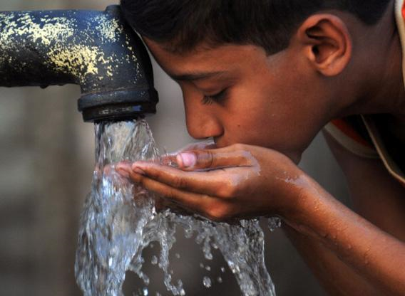
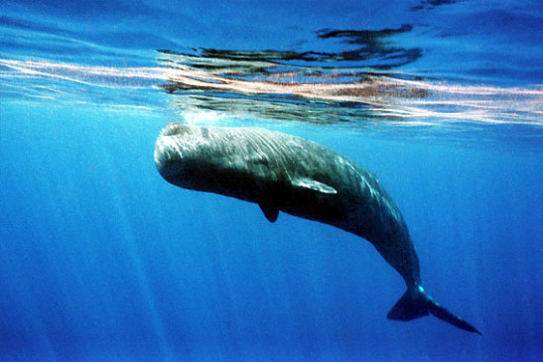
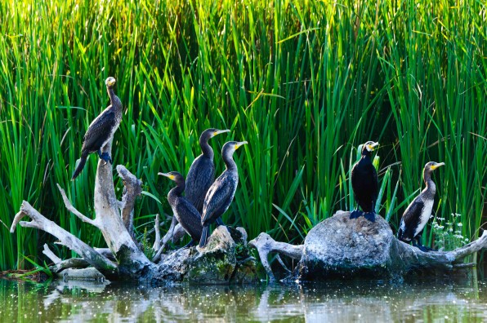
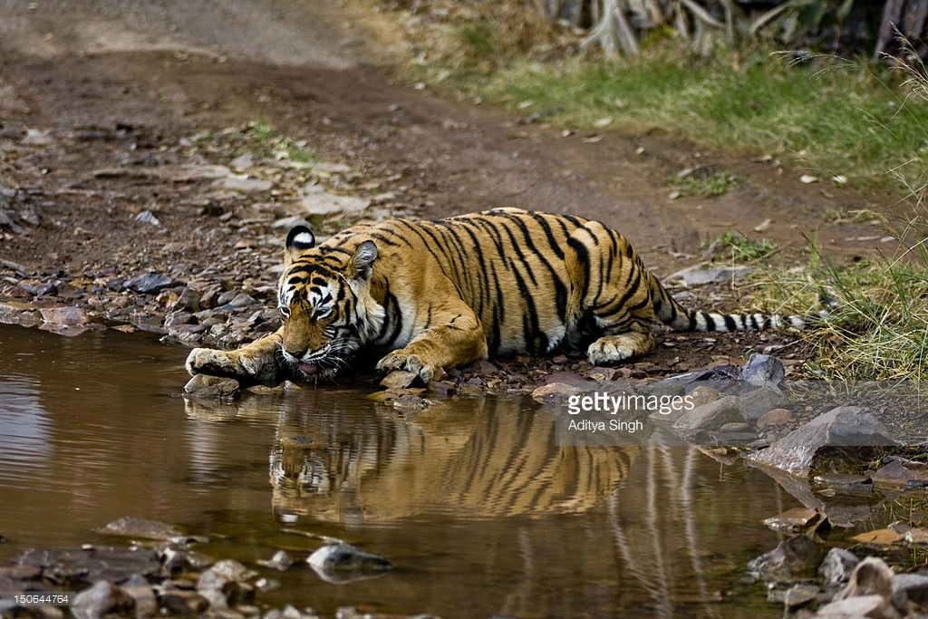

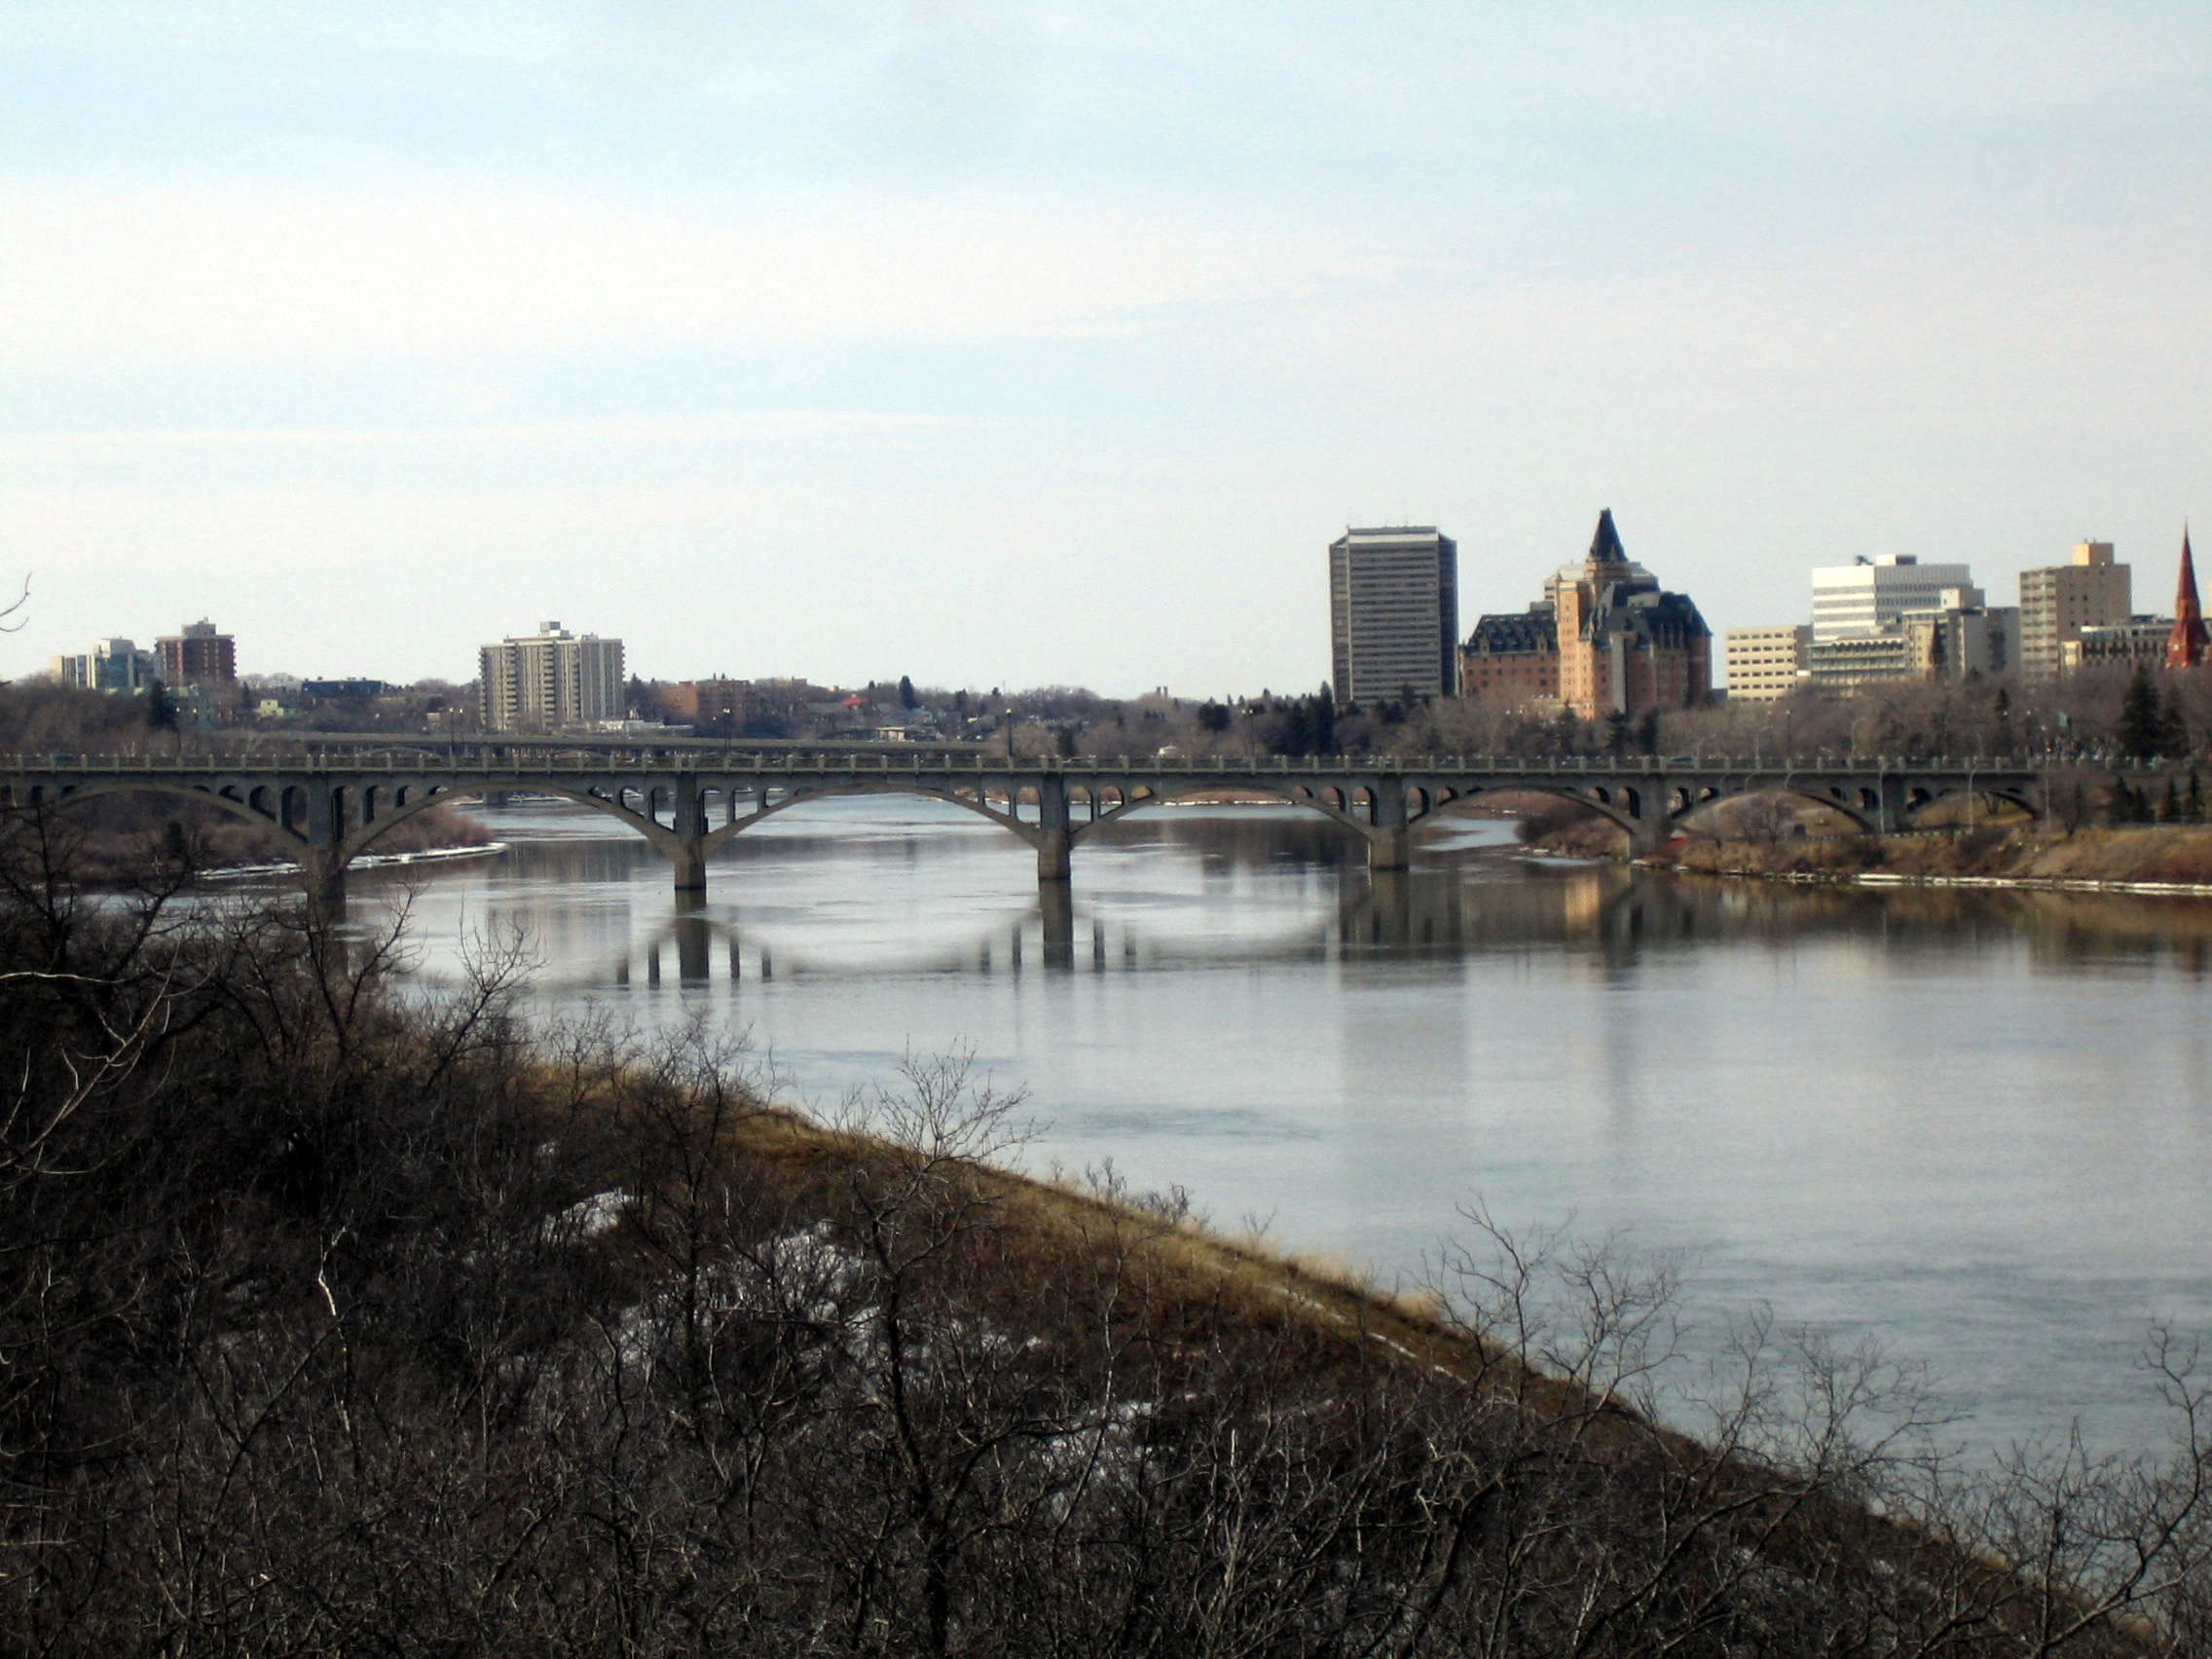
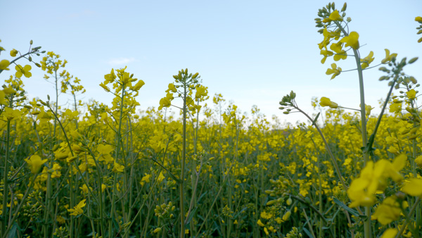

Slide 3
What is water management and why its important ?
Water management___ Water management is the activity of planning, developing, distributing and best use of water resources under defined water polices and regulations.
It includes: management of drinking water, industrial water, sewage or waste water and management of flood protection etc.
EFFECTIVE WATER MANAGEMENT
IMPROVED WATER SUPPLY/QUALITY
ECONOMIC DEVELOPMENT
POVERTY

Slide 4
Public Interest Litigation and EIA
PIL and EIA “ a systematic process
of identifying future consequences
of current and proposed action, and
strengthens ‘governmental authority,
civil society and encourages
sustainable development.”
Accountability
Transparency
Better acceptance of decisions
Certainty
Effectiveness
Flexibility
Better quality decisions
Credibility

Slide 5
India,Public Participation in Decision Making and Environment/Water
Public Interest Litigation and Public Participation
Environmental Impact Assessment

Slide 6

Indian Water Management and Public Participation
Gaps in the Indian Constitution and Public Interest Litigation
Right to Clean Environment under Article 21 of the Indian Constitution
Water Law and Public Interest Litigation
Sustainable Development
Doctrine of Public Trust
Principle of Absolute Liability
Precautionary Principle
Polluter Pays Principle

Slide 7
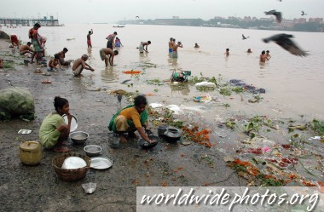
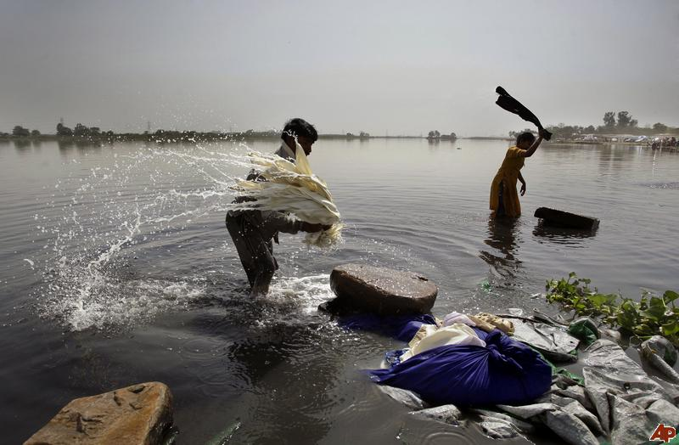
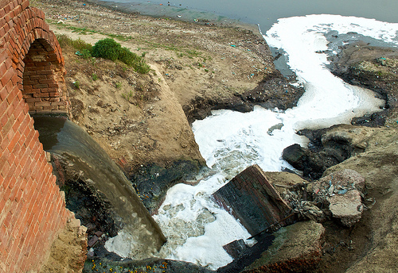
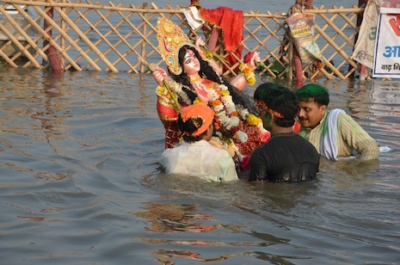
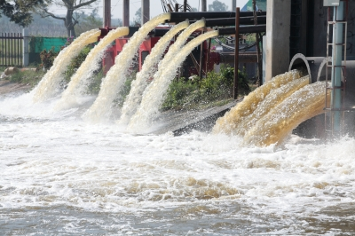
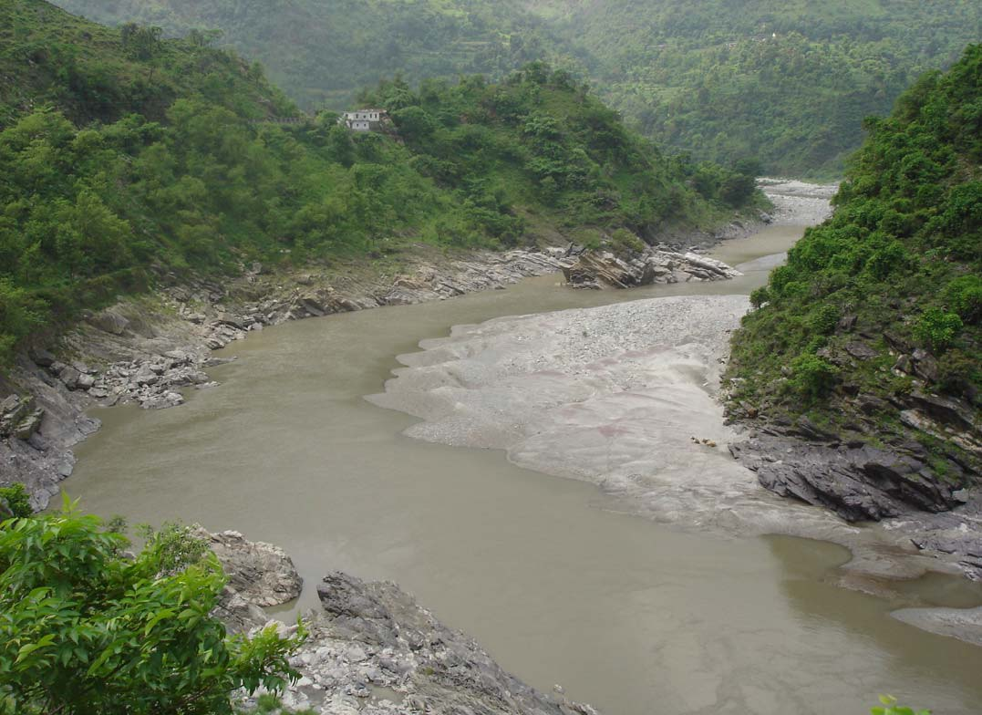
Societal Relationship with Water in India

Slide 8
Current Data on Water Pollution Levels in India
Water Quality Monitoring Reports
Central Pollution Control Board Report (Gov. report)
Comptroller and Auditor General (Govt. report)

Slide 9
Current Data on Water Pollution Levels in India
Water Quality Monitoring Reports | Central Pollution Control Board Report 2013 | Comptroller and Auditor General of India
During 1995-2010 indicate that the organic pollution in terms of BOD and Coliform bacterial count does not meet the criteria and concept of DOB set by the Central Pollution Control Board. | 80% of the cities situated on the bank of the river have neither proper sewage nor drainage system. | Ministry of Environment and Forest (MoEF), Central Pollution Control Board (CPCB), and State Pollution Control Boards (SPCBs) do not have complete and comprehensive data about various kinds of waste being generated in India.
Nearly 60% of the observations are having BOD less than 3 mg/l, 22% between 3-6 mg/l & 18% above 6 mg/l. | CPCB has also inventorized 764 grossly polluting industries discharging wastewater to main stem of River Ganga (either directly or through drains). | Rules framed for safe disposal of waste did not cover many kinds of waste like construction &demolition waste, electronic waste, agricultural waste etc.
Total & Faecal coliform, which indicate presence of pathogens in water, are also a major concern

Slide 10
UK, Public Participation in Decision Making in Environment/ Water
Public Participation and Strategy Development 1994
Water Framework Directive (Directive 2000/60/EC of the European Parliament and of the Council of 23 October 2000 Establishing a Framework for Community Action in the Field of Water Policy)
Aarhus Convention 1998, ratified by the UK in 2005
Implications of the Amended Environmental Impact Assessment (EIA) Directive (Directive 2014/52/EU)

Slide 11
Limitations of Public Participation in UK
PCO
Claimant is required to give a cross under taking in damages before being granted interim relief
Criminal Justice and Courts Act 2015

Slide 12
Deficiencies in Public Participation with reference to Water Management in the UK
The Water Framework Directive (WFD) (EC 2000) and the Aarhus Convention (1998), there is ambiguity around the exact way participation should be approached.
Discretionary power of the Organisations to determine who they consider as relevant participants and what degree of involvement is appropriate within the context of their project.
The Catchment Abstraction Management Strategy and stakeholders participation

Slide 13
Quality of Surface Water in the UK
According to the report of the UK National Ecosystem Assessment (2011), UK river water quality, measured using traditional chemical and biological indicators, has improved significantly
In 2015, 35% of surface water bodies assessed under the Water Framework Directive (WFD) in the UK were in high or good status. This reflects very little change from 36% of surface water bodies assessed in 2010.
According to the report, drinking water quality in UK has also improved a lot since the adoption of EU directives

Slide 14
Can these two countries benefit from understanding each other's legal system to improve public participation in promoting higher levels of water quality

Slide 15


