Slide 1
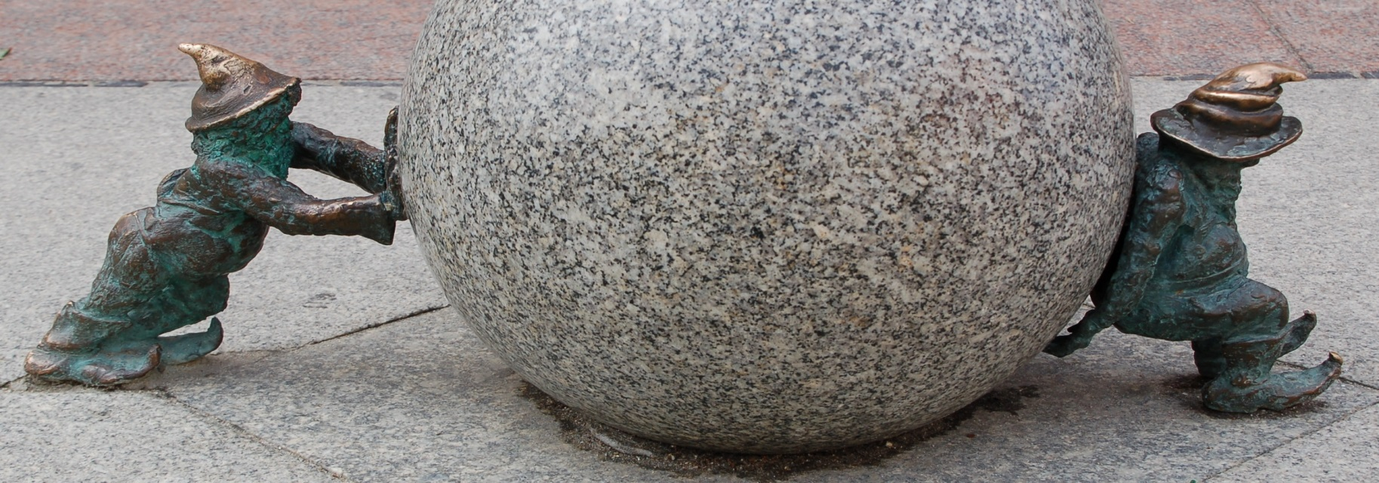
EELF Conference 2016 (Wrocław 14-16 October) Procedural Environmental Rights: Principle X in Theory and Practice
Nicola Lugaresi (Trento University Law School - Italy)
Sustainable development in the ILVA case:
can it really help?

Slide 2
OUTLINE
THE ILVA CASE
- a history of failures
- a history of conflicts
ENVIRONMENTAL LAW
- IPPC permits
- environmental management systems
- clean-ups and environmental restoration
SUSTAINABLE DEVELOPMENT AND PRINCIPLE X
- sustainable development at a national level
- “ineffective” information and participation

Slide 3
ILVA: AN OVERVIEW

Slide 4
SOCIAL AND ECONOMIC DATA (sources: www.gruppoilva.com/)
DIMENSIONS
Largest steel plant in Europe
15 km² area; 200 km railways; 50 km roads; 190 km conveyor belts; 6 docks (source: ILVA website 2009) 76% shipping movements Taranto harbor
ECONOMY
1° steel plant in Italy, 2° in Europe (production)
4,7 million tons steel production (2015; it was 8,3 in 2012)
10 billions gross revenue
75% GDP Taranto
20% regional export (source: ILVA website 2009)
EMPLOYMENT
11.967 workers (source: ILVA website 2009)
8.000 employed in subsidiary activities (source: ILVA website 2016)

Slide 5
HEALTH AND ENVIRONMENT DATA
POLLUTION (source: E-PRTR 2014)
PCDD + PCDF (dioxins + furans) (as Teq) 1,300 g
Particulate matter (PM10) 217 t
Nitrogen oxides (NOx/NO2) 5.700 t
Sulphur oxides (SOx/SO2) 4.420 t
Carbon dioxide (CO2) 7.420.000 t
Benzene 3,78 t
Arsenic and compounds (as As) 38,2 kg
Nickel and compounds (as Ni) 659 kg
Lead and compounds (as Pb) 63,4 kg
HEALTH (source: Istituto Superiore di Sanità, studio «Sentieri» 2003-2008)
+30% cancer mortality (Taranto vs national average)
+10% breathing system related illnesses mortality (Taranto vs national average)

Slide 6
ILVA CASE AS WE KNOW IT: HOW IT STARTED

Slide 7
ILVA: HISTORY AND RECORDS
THE COMPANY AND THE PLANT
1905: ILVA (company) founded
1934: ILVA becomes public (IRI)
1965: Taranto plant inaugurated
1995: Taranto plant privatized
BEFORE THE STORM
2004: ISO14000 certified
2008: private laboratory tests on pecorino
2011: IPPC permit issued
THE INSTITUTIONAL CONFLICTS
2012: judicial seizure
2012: IPPC permit reconsideration
2012: (first) “save-ILVA” decree
2013: Constitutional Court on (1st) “saving-Ilva” decree
2012-2016: ten “save-ILVA” decrees
EUROPE
2013: EU infringement procedure (environmental)
2016: EU infringement procedure (State aid)
2016: case opened before ECHR
EXIT STRATEGY
2013: ILVA under “special commissioner”
2015: ILVA under “special administration”
2016: ILVA put up for sale
2017: ILVA sold?

Slide 8
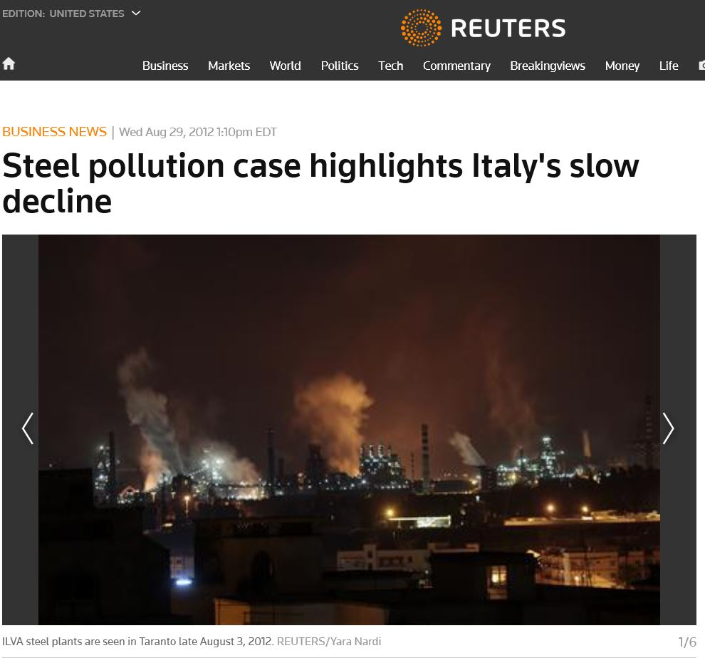
SEEN FROM ABROAD: THE “SLOW DECLINE” (source: Reuters 2012)
… years of uncontrolled environmental abuse …
… ILVA is a stark example of the suffocating mix of short-term political expediency, poor oversight and endemic corruption that has given Italy the most sluggish economy of any eurozone country …
… the case points to the weakness of the institutions supposed to regulate industry …
… many questions remain …, and in particular why the plant was granted an environmental clearance in 2011 …

Slide 9
ILVA: CONFLICTS

Slide 10
INSTITUTIONS AND INTERESTS
Preliminary hearing criminal judge (court order 26 July 2012)
Right to life (and health) absolutely prevailing on other rights
«Death vs jobs» assessments: a legal absurdity
Seizure aimed at stopping production
Administrative judges (20+ years)
Administrative provisions inconsistent and flawed
Sustainable development: balance among fundamental rights
Law decree 207/2012
IPPC (new) permit allows production (even under judicial seizure)
Constitutional Court 85/2013
Reasonable balance among rights (health, environment, work)
Reasonable «provisional law»

Slide 11
ILVA: SUSTAINABLE DEVELOPMENT

Slide 12
SD IN (NATIONAL) THEORY AND PRACTICE
Article 3-quater, d.lgs. 152/2006 (“Environmental code”)
§1. Every legally relevant human activity must comply with SD
§2. Public administration activity must aim at implementing SD
§3. SD must point out a “resources balance”
§4. Controversies involving environmental aspects must be solved ensuring SD
National level: SD misunderstood and/or misused and/or “mistranslated” and/or useless (rhetoric and demagogy)
SD and administrative discretion

Slide 13
ILVA: INFORMATION

Slide 14
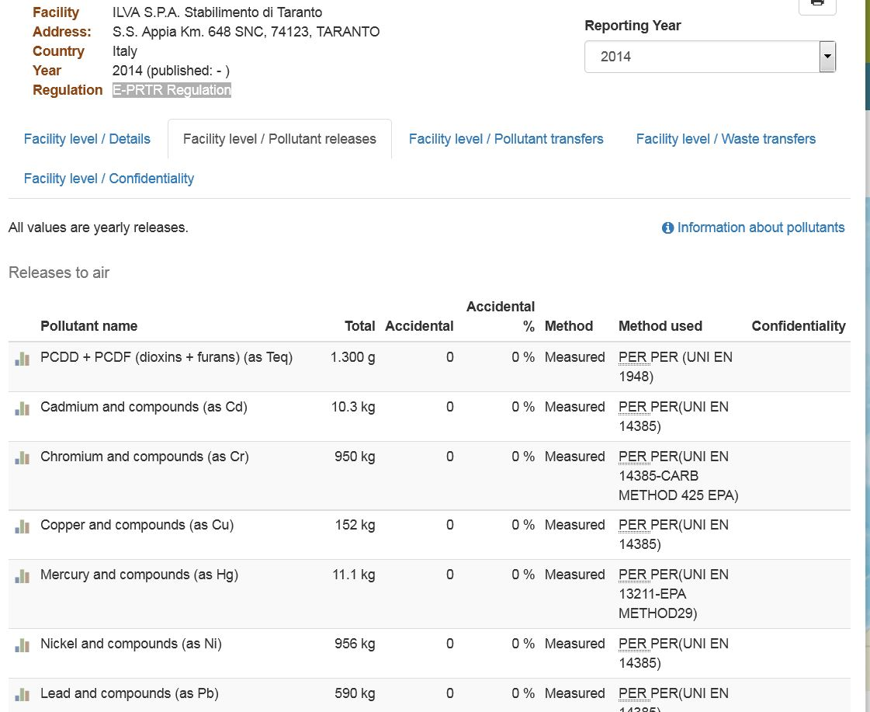
ILVA: E-PRTR DATA (2014) (source: E-PRTR website)

Slide 15
INDUSTRIAL AIR POLLUTION COSTS (source: EEA website)
List of individual facilities (2009)
ILVA
2° in Italy
52° in Europe

Slide 16
ILVA (www.ilvataranto.com/videoFoto.aspx)

Slide 17
ILVA (www.inchiostroverde.it/news/attualita/giornalisti-ilva.html)

Slide 18
ILVA (www.ecoreport.tv)

Slide 19
ILVA: PARTICIPATION

Slide 20
PARTICIPATION
IPPC (and ISO14001)
«Law provisions»
Selling procedure
The Taranto referendum (2013)

Slide 21
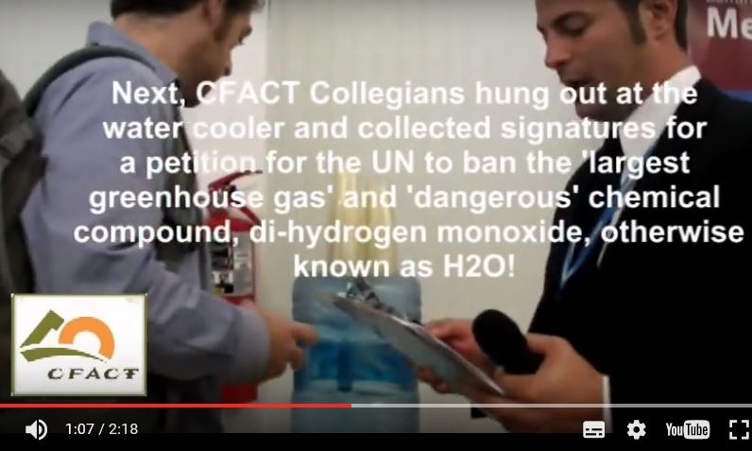
Dihydrogen monoxide case
BAN PETITION
CANCUN 2010
Death due to accidental inhalation
Severe tissue damage due to prolonged exposure
Major component of acid rain
Gaseous DHMO can cause severe burns
Contributes to soil erosion
Corrosion and oxidation of many metals
Electrical failures and decreased effectiveness of automobile brakes

Slide 22
CONCLUSIONS

Slide 23
CONCLUSIONS
ILVA: a political, economic, social, environmental nightmare
Going beyond SD: traditional political and administrative choices
Information (Principle X): coeherent and organized data and public education (how to interpret)
Participation (Principle X): effective tools and critical thinking (how to contribute)

Slide 24
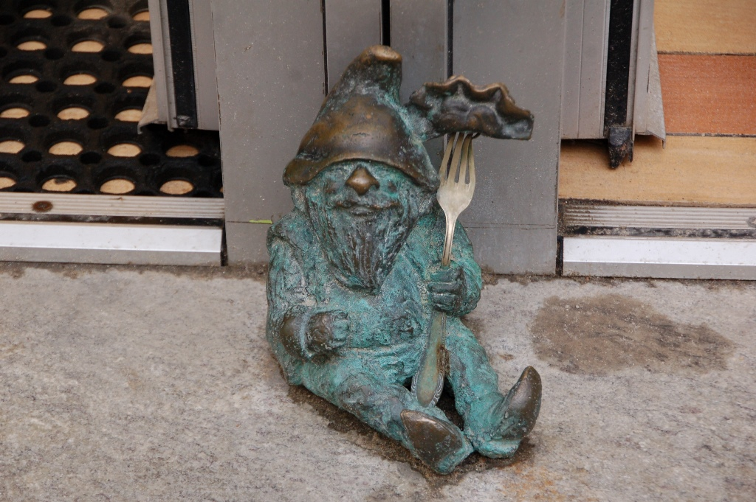
Skończyłem (source: Google translator)

