Slide 1
Access to information and the Paris Agreement
Spreading Aarhus or Aarhus’s impact?
Prof. Delphine MISONNE
Saint-Louis University Brussels - FNRS
Belgium
delphine.misonne@usaintlouis.be

Slide 2
Paris Agreement on Climate Change
Adopted last December in Paris
Binding Treaty – awaiting entry into force – ratification process is moving forward
A Treaty in the continuity of the 1992 UNFCCC
With a different type of content from what the Kyoto Protocol did contain
‘Bottom-up’ INDC’s
With a strong accent placed on ‘transparence’ in the verification of how Parties with comply with their own ‘nationally-determined commitments’

Slide 3
Paris and Transparency, Art. 13
Requires Parties to be more transparent about their Climate Action
Shall be at the hearth of further discussions
Will serve a critical role in successfully implementing the Paris Agreement.

Slide 4
The Paris Agreement, Art.12
Parties shall cooperate in taking measures, as appropriate, to enhance climate change education, training, public awareness, public participation and public access to information, recognizing the importance of these steps with respect to enhancing actions under this Agreement’

Slide 5
Question
Shall the Climate agreement be a vehicle for consolidating fundamental democratic values accross the globe?
Is it the ‘human rights touch’ of the Paris Agreement?

Slide 6
Recognizing the importance…
“recognizing the importance of these steps with respect to enhancing actions under this Agreement”
Is this Aarhus spreading?
N.B. Aarhus Convention: not worlwide – only 47 (46+1) Parties

Slide 7
Naïve?
Rather Aarhus’s impact?
Art. 3, §7 – Aarhus Convetion: « Each Party shall promote the application of the principles of this Convention in international environmental decision-making processes and within the framework of international organizations in matters relating to the environment ».

Slide 8
3 questions
a trend or a breakthrough? ;
Does this interest in access to information already crystallize in the ‘INDC’s’ ?
How could the crucial and specific focus on transparence, which is at the very heart of the Paris Agreement, be inspired or even moulded by true procedural rights to access to information ?

Slide 9
1. A trend or a breakthrough?
In Climate Change Treaties
Principle X: “Environmental issues are best handled with participation of all concerned citizens, at the relevant level. At the national level, each individual shall have appropriate access to information, etc…
Rio UNFCCC, 1992 - art.6.

Slide 10
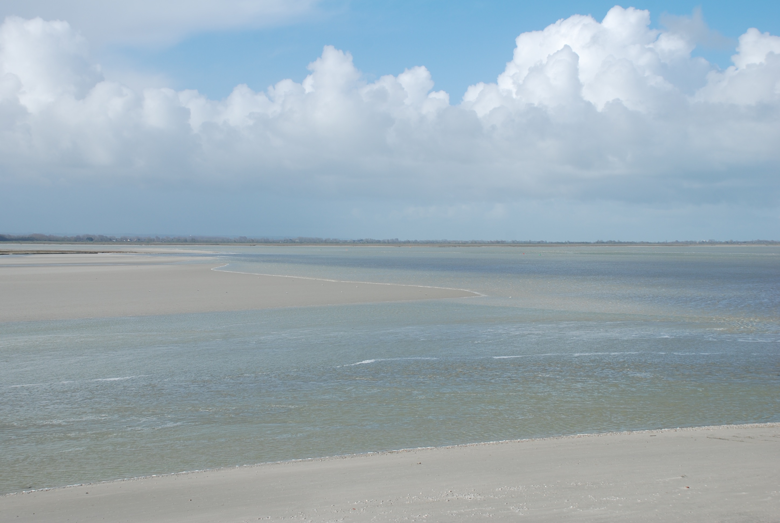
Rio - Kyoto
Art. 6, UNFCCC: Parties shall ‘promote and facilitate at the national and, as appropriate, subregional and regional levels, and in accordance with national laws and regulations, and within their respective capacities: (…) (ii) public access to information on climate change and its effects.
Kyoto, Art.10, e: ‘All Parties shall facilitate at the national level public awareness of, and public access to information on, climate change’

Slide 11
And the surprise is:
Quite intense diplomatic activity
around Art.6
‘Doha Work Programme’ 2012: encourages Parties to prepare a national strategy on Article 6 of the Convention;
Mostly with developing countries? 2016 Report: ‘low literacy rates as a major obstacle to the successful implementation of public access to information’.
Enormous amount of work around Principle 10, outside Aarhus

Slide 12
For what result in Paris?
Parties shall cooperate in taking measures, as appropriate, to enhance climate change education, training, public awareness, public participation and public access to information, recognizing the importance of these steps with respect to enhancing actions under this Agreement’

Slide 13
A cooperation on Access to Information
= we need financing?
= don’t forget that important issue, in all new instruments (finance, specific mechanisms)
= a new transnational dimension in Climate policies?

Slide 14
Access to information
Art.6 UNFCCC
National level
National strategies
Art.12 Paris
Cooperation
Towards a common framework?
A duty?

Slide 15
A trend, YES But with various dimensions
Access to (their own) information
Cooperate on Access to information
Access to the (negotiation-related) information – Aarhus, art.3

Slide 16
Access to the negotiation
Aarhus’s potential extends beyond its own institutional framework
The ALMATY Guidelines 2005
EX: Belgian delegation – Quite unique

Slide 17
II. The INDC’s
what post-2020 climate actions Parties intend to take under the new international agreement
DO they contain something on Access to information?
YES, some do

Slide 18
INDC’s Costa Rica
Transparency and Accountability
Costa Rica has adopted an Open Government policy. It is looking into strengthening accountability mechanisms, information access and availability, and citizen participation. The National Environmental Information System (SINIA) was created under the National Geo- Environmental Information Center (CENIGA) at the Ministry of Environment and Energy, and is hoping to promote an open data policy for all relevant climate information available for any citizen. There will be, as well, two open participation councils, one technical-scientific and one multi-stakeholder platform which will accompany the government’s climate planning and management.

Slide 19
China
N. Broad Participation of Stakeholders
To enhance the responsibility of enterprises for low-carbon development and to encourage them to explore low-carbon development modes that are resource-saving and environment-friendly;
To strengthen the role of public supervision and participation in low-carbon development;
To use platforms such as National Low Carbon Day to raise public awareness of low-carbon development throughout society; etc

Slide 20
Mexico
Ensure capacity building and participation of the society, local communities, indigenous peoples, women, men, youth, civil organizations and private sector in national and subnational climate change planning.
Reduce the population’s vulnerability and increase its adaptive capacity through early warning systems, risk management, as well as hydrometeorological monitoring, at every level of government.

Slide 21
UN, May 2016 report on Progress made in implementing the Doha work programme on Article 6 of the Convention
« Around 134 Parties mentioned at least one of the six elements covered by Article 6 of the Convention in their INDCs. Several Parties reported that they involved civil society, the private sector, academia, NGOs, multilateral organizations and other relevant stakeholders in the design of their INDCs. Some Parties indicated that public participation will be enhanced for coordinating and implementing their INDCs. »

Slide 22
III. More transparency & more access to information = no climate change policies without procedural rights? How?
Needs further elaboration
Back to human rights
A new addition to the duty of care
Mitigation & adaptation
Towards new common framework?

Slide 23
Work on Art.12 & Art.13 together
Art.12 (access to information) and Art.13 (transparency framework) do not seem connected
Why?
RECONNECT
Public scrutiny on all INDC’s: adoption, implementation?
Stakeholders: back-up role?

Slide 24
Human Rights
Climate change and human rights
No explicit mention of ‘human rights’ in the core of the Paris Agreement
But procedural (rights) are (more than) between the lines
Cfr Report of the Special Rapporteur on the issue of Human Rights, 2016

Slide 25
Lessons of the past
Climate policies versus human rights
Now: an issue for further cooperation, not just a technical aspect

Slide 26
Help spreading Aarhus
« at least half of the nations of the globe have adopted comprehensive legislation aimed at guaranteeing access to environmental information, whether through general, cross- cutting information laws, or through laws dealing specically with environmental information ». (as mentioned in Unep, 2015, Putting Rio Principle 10 into Action)
The second half?

Slide 27
Or, again, rather Aarhus ‘s spillover-effect
A true catalyst
Beyond soft law
CONCLUSIONS

Slide 28
delphine.misonne@usaintlouis.be

