Slide 1
Legal aspects of public participation in the ecosystem-based water management in the Baltic Sea Region
Maciej Nyka
Economic Law and Environmental Protection Chair
University of Gdansk

Slide 2
overview
Ecosystem based approach and it’s principles
Adaptive management and public participation
Good environmental status of waters and warranting access to water services as public goods
Examples of public participation in Baltic Sea water management regulation

Slide 3
Ecosystem-based approach (EBA)
EAM Working Group (European Commission, 2004): The Ecosystem Approach is an ‘integrated management of human activities in ecosystems, based on the best available science, to achieve sustainable use of ecosystem goods and services and the maintenance of ecosystem health. Management should be adaptive and will take account of environmental variation and change’.
OSPAR & HELCOM (2003). The Ecosystem Approach is “the comprehensive integrated management of human activities based on the best available scientific knowledge about the ecosystem and its dynamics, in order to identify and take action on influences which are critical to the health of marine ecosystems, thereby achieving sustainable use of ecosystem goods and services and maintenance of ecosystem integrity”.

Slide 4
Goals of EBA
Protection of
Health
Productivity
Resilience
Ecosystem goods/services
in/of ecosystems

Slide 5
Principles of EBA
Principle 1:The objectives of management of land, water and living resources are a matter of societal choices.
Principle 2: Management should be decentralized to the lowest appropriate level.
Principle 3: Ecosystem managers should consider the effects (actual or potential) of their activities on adjacent and other ecosystems.
Principle 4: Recognizing potential gains from management, there is usually a need to understand and manage the ecosystem in an economic context. Any such ecosystem-management programme should:
  Reduce those market distortions that adversely affect biological diversity;
  Align incentives to promote biodiversity conservation and sustainable use;
  Internalize costs and benefits in the given ecosystem to the extent feasible.
Principle 5: Conservation of ecosystem structure and functioning, in order to maintain ecosystem services, should be a priority target of the ecosystem approach.
Principle 6: Ecosystem must be managed within the limits of their functioning.
Principle 7: The ecosystem approach should be undertaken at the appropriate spatial and temporal scales.
Principle 8: Recognizing the varying temporal scales and lag-effects that characterize ecosystem processes, objectives for ecosystem management should be set for the long term.
Principle 9: Management must recognize the change is inevitable.
Principle 10: The ecosystem approach should seek the appropriate balance between, and integration of, conservation and use of biological diversity.
Principle 11: The ecosystem approach should consider all forms of relevant information, including scientific and indigenous and local knowledge, innovations and practices.
Principle 12: The ecosystem approach should involve all relevant sectors of society and scientific disciplines.
Notes:
From the Convention on Biological Diversity

Slide 6
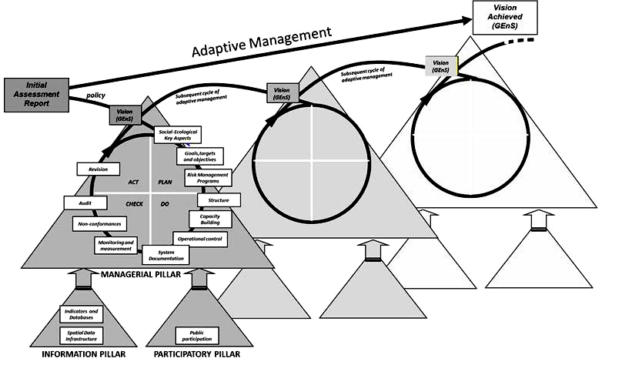
Adaptive management (AM)
Sardà, R., T. O'Higgins, R. Cormier, A. Diedrich, and J. Tintore 2014. A proposed ecosystem-based management system for marine waters: linking the theory of environmental policy to the practice of environmental management. Ecology and Society 19(4):51.

Slide 7
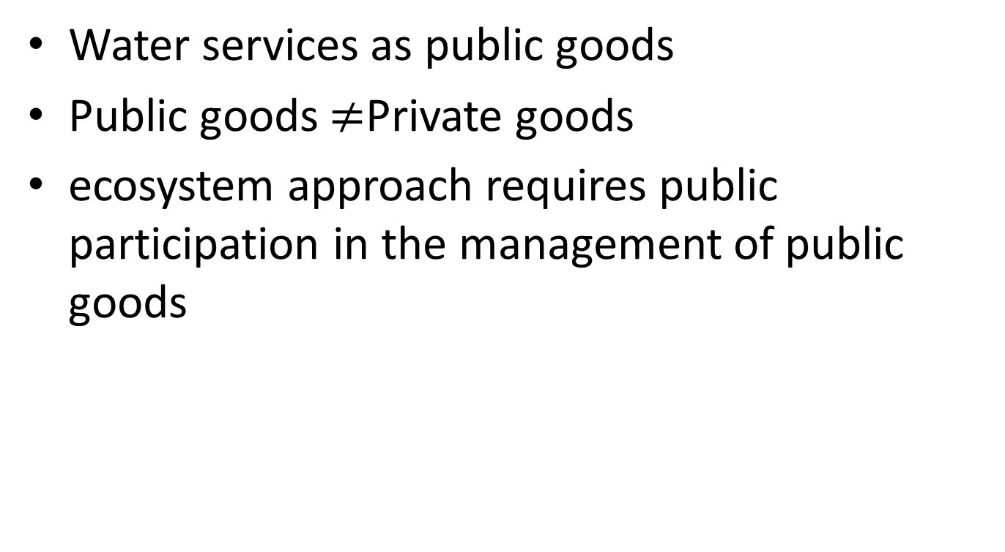
Reasons for public participation in water management
Water services as public goods
Public goods $≠$Private goods
ecosystem approach requires public participation in the management of public goods
Notes:
In Europe, according to the Marine Strategy Framework Directive (European Commission 2008), management of the marine environment should be based on a “process” intended to reach and/or maintain Good Environmental Status (GEnS) by applying ecosystem approach principles (Borja et al. 2010, 2013). Given that public goods, are different in nature from private goods and that an ecosystem approach requires public participation in the management of public goods, it follows that a new set of management practices is needed to implement this new approach.

Slide 8
Public participation in ecosystem-based approach
Implementing EBA
  Public Access to Information
  Public Education
  Public Dialogue (and Participation)
Functioning of EBA
  Information Access and Decision-Making Input
  Leveling the Playing Field
  Intragenerational/intergenerational justice

Slide 9
Examples of Ecosystem-Based water management in the Baltic Sea region water regulations
International Law (Helsinki Convention)
  Baltic Sea Action Plan
EU Law
  Water Framework Directive EU
  Marine Strategy Directive
National Laws
GOOD ENVIRONMENTAL STATUS OF WATER

Slide 10
Good Environmental Status
‘good environmental status’ means the environmental status of marine waters where these provide ecologically diverse and dynamic oceans and seas which are clean, healthy and productive within their intrinsic conditions, and the use of the marine environment is at a level that is sustainable, thus safeguarding the potential for uses and activities by current and future generations,
AM
EBA
GES

Slide 11
Baltic Sea Action Plan
Awareness raising and capacity building
  Access
    Geographic Information System
  Education
    Information campains
    Public awarness programme for illegal discharges
    Awarness rising (marina guest)
  Dialogue/Participation
    Implementation
    Promotion of healthy Baltic Sea
    Civil society engagement

Slide 12
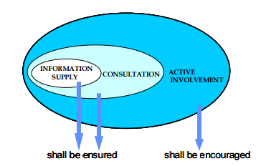
Water Framework Directive
Preamble (14) „The success of this Directive relies on close cooperation and coherent action at Community, Member State and local level as well as on information, consultation and involvement of the public, including users.”
Art.14 WFD
River Basin Management
Plan (Ecosystem Based
Approach)
requirements of Article 14 WFD (Public information and consultation)
Reference: Guidance on Public Participation in relation to the Water Framework Directive, December 2002

Slide 13
Marine Strategy Directive
Preamble (36) „To ensure the active involvement of the general public in the establishment, implementation and updating of marine strategies, provision should be made for proper public information on the different elements of marine strategies, or their related updates, as well as, upon request, relevant information used for the development of the marine strategies in accordance with Community legislation on public access to environmental information”
Art. 13 (6) Access to information (marine strategies)
Art. 19

Slide 14
Conclusions
Public Participation is fundamental to Ecosystem Based Approach and to Adaptive Management
Good Ecological Status (Goal of water can be achieved only with Information, Education and Participation
EU/INTERNATIONAL/NATIONAL documents identify the need of public involvement
Public participation is ensured at relatively high level – lack of public participation at the lowest level (water permit)

Slide 15
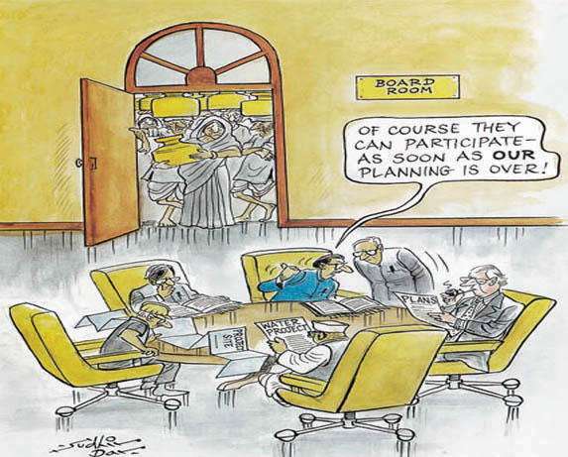
Thank you for your attention

