Slide 1
Participation in English and Dutch surface water quality policy
Faculty of Law, Economy and Governance
Department of Law
Ernst Plambeck
PhD candidate

Slide 2
Outline
Department of Law
  Introduction
  Assessment Framework
  Arnsteins ladder
  Characterisation
  Policy Cycle
  Case studies
    PP in The Netherlands
    PP in England
    Comparison
  Conclusion

Slide 3
Introduction
Department of Law
From ‘government’ to ‘governance’ approach
Identified in policy sciences, public administration and legal sciences
Underlying mechanisms (participatory paradigm):
  stakeholders want to participate in and enforce regulatory processes;
  both leads to a legitimate and effective regulatory process from rule making to the results achieved;
  in the end participation and enforcement by stakeholders results into goal realisation.

Slide 4
Assessment Framework
Department of Law
Evaluation criteria
  (Input) Legitimacy
  Effectiveness = output legitimacy
Participation
Strength
Compliance
Theoretical
Depth
Norm or standard setting
Enforcement mechanisms
Width
Notes:
Depth = the degree to which stakeholders have the opportunity to influence the outcome of the policy process. Arnsteins ladder
Width = the degree to which each member of a community has the opportunity to participate in each phase of the policy process.

Slide 5
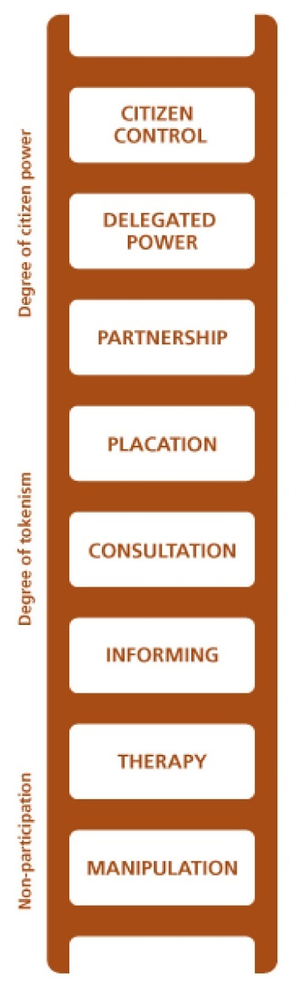
Arnsteins ladder

Slide 6
Characterisation
Department of Law
Characteristics | Dangerous Substances Directive | Nitrates Directive | Water Framework Directive
Bottom-up regulation | -- | +/- | +
Open standards | -- | +/- | +
Principle-based regulation | -- | -- | ++
Procedural rules | -- | + | ++
Much room for MS to deviate/adapt | -- | + | ++
Participation is a prerequisite | -- | +/- | ++
Arrangements | -- | +/- | ++
E.J.H. Plambeck, ‘Paradoxes of the EU regulatory framework in water management: developing and assessment framework to put the governance approach to the test’, Water Law 2015 (x), pp.

Slide 7
Policy Cycle
Department of Law
Programmes Policy Framing
Legal Instruments Policy Implementation
Monitoring & Enforcement Monitoring & Evaluation
Goal setting Problem Framing

Slide 8
Case Studies: Participation for 3rd parties in NL
Department of Law
 | Mercury |  | Nitrate |  | Zinc
Goal setting | Concrete norm, same as EU, applies only to designated water bodies; in Order in Council | Internetconsultation (not obliged) | Concrete norm only applies to drinking water; in Order in Council | Internetconsultation (not obliged) | Indirect norm via monitoring parameter | No
Programmes | Waterplan (RBMP) | UPP (SEA), everyone | NAP (no legal basis) | SEA | Waterplan (RBMP) | UPP (SEA), everyone
Legal Instruments | Discharge consent for 10 years with emission limits in ministerial regulation | UPP, everyone | General rules; Exemption | Internetconsultation (not obliged) Adm. review | Discharge consent | UPP, everyone
Monitoring & Enforcement | Adm. Restoration Measures | Only request by interested party | Adm. Fine | Only request by interested party | Adm. Restoration Measures | Only request by interested party

Slide 9
Case Studies: Participation for 3rd parties in England
Department of Law
 | Mercury |  | Nitrate |  | Zinc
Goal setting | Concrete norm, lower than EU; in Regulations | Consultation | Designation NVZs in Regulations | Consultation | EQS in RBMP | UKTAG; consultation
Programmes | RBMP | Consultation (SEA); liaison panels | NAP | Consultation (SEA); liaison panels | RBMP | Consultation (SEA); liaison panels
Legal Instruments | Env. Permit for discharges and ind. activities | Consultation | General rules | Consultation | Env. Permit and standard rules | Both consultation
Monitoring & Enforcement | Offences and enforcement notices | No | Offences and enforcement notices | No | Offences and enforcement notices | No

Slide 10
Comparison
Department of Law
 | Mercury |  | Nitrate |  | Zinc
 | NL | England | NL | England | NL | England
Goal setting | If, then consultation | Consultation | If, then consultation | Consultation | Therapy/manipulation | Consultation
Programmes | Consultation | Placation | Consultation | Placation | Consultation | Partnership
Legal Instruments | Consultation | Consultation | If, then consultation | Consultation | Consultation | Placation
Monitoring & Enforcement | Placation | Informing | Placation | Informing | Placation | Informing
Notes:
What we see is that in England the government is more willing involve participation in decision-making process. The Netherlands we’re very reluctant. With regard to the depth of participation, England even scores higher with more possibilities to influence and shape the outcome of fhe final decision in the whole policy cycle. More important, in England there are more possibilities to participate in the different stages of the phases within the policy cycle. So, in the end we can conclude that surface water quality policy in England is more legitimate than in the Netherlands, but is it also effective? That’s the question. We see there are no or less possibilities for stakeholders to initiate an enforcement procedure in England. So, the follow up of my research is to go into depth with regard to the possibilities for stakeholders to pursue compliance, thus the effectiveness part.

Slide 11
Conclusion
Department of Law
Follow up
Compliance: effectiveness
Overall conclusion on approaches

