Slide 1
Participatory rights of indigenous peoples in the Arctic Council to safeguard marine biodiversity
Margherita Poto
Postdoc at the UiT/JCLOS
Contact: margherita.poto@uit.no

Slide 2
IP Participatory rights in a nutshell
Introduction
The Arctic Council in the Global Arena
Indigenous Peoples at International Level
The principle of Self-Determination and the spoke hub distribution paradigm
Indigenous Peoples in the Arctic Council
Cases of Participation
Conclusions

Slide 3
Margherita Poto
2001- 2006 PhD
Research on IAA
Financial Sector Liability
(EU and MS: IT, UK, DE)
2006 – 2009 Post Doc
Comparative Administrative Law
(Food Law, Environmental Law, GAL)
2009-2016
Comparative Food Law
(EU, Asia, China)
2016 TromsØ: Arctic Council

Slide 4
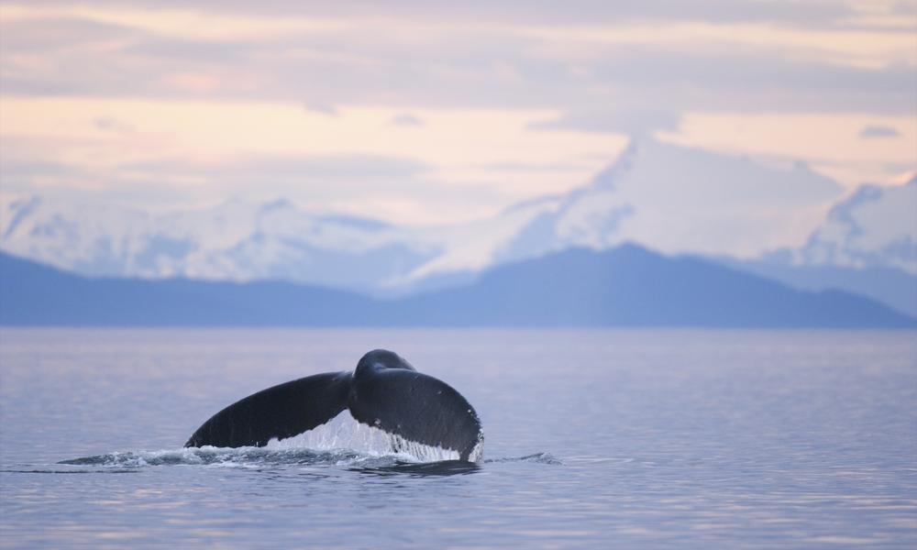
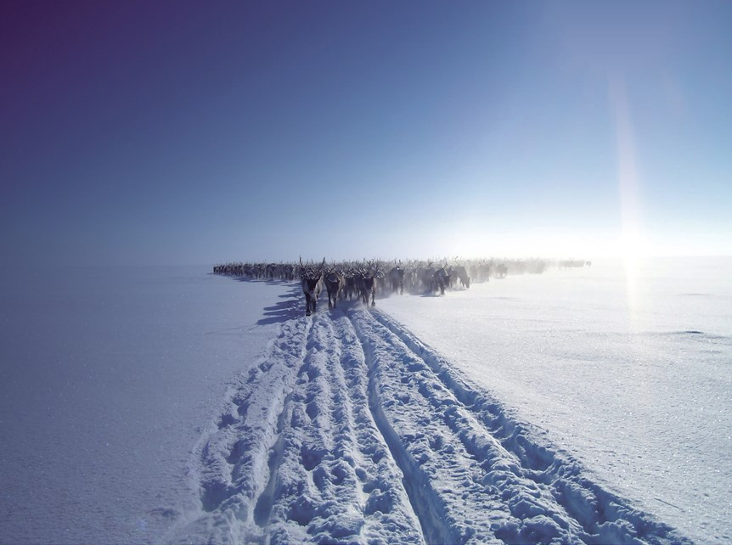
THE ARCTIC REGION

Slide 5
The Arctic Council

Slide 6
Global dynamics: interconnected levels: multilevel governance

Slide 7
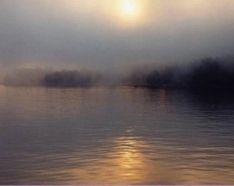
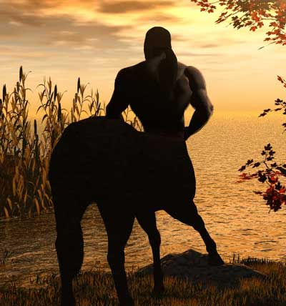
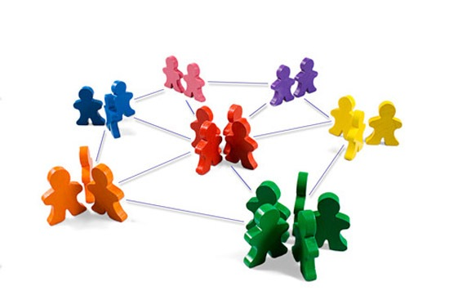
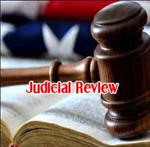
1. No hierarchy 2.No distinction public-private 3.Global regulatory bodies 4.Good admin principles 5.Judicial review

Slide 8
The Alter-Globalisation and its Actors
Pursuing interestS different from the market driven logic (peace, human rights, environment)
State and non-State Actors
Transnational Bodies, Technical Agencies with high level of bottom-up participation

Slide 9
The Arctic Council: its Members

Slide 10
Indigenous Peoples at International Level
peoples in independent countries who are regarded as indigenous on account of their descent from populations which inhabited the country, or a geographical region to which the country belongs, at the time of conquest or colonization or the establishment of present states boundaries and who, irrespective of their legal status, retain some or all of their own social, economic, cultural and political institutions (Ilo Convention 169 Art. 1 (1b))
Indigenous communities, peoples and nations are those which, having a historical continuity with pre-invasion and pre-colonial societies that developed on their territories, consider themselves distinct from other sectors of the societies now prevailing in those territories, or parts of them. They form at present non-dominant sectors of society and are determined to preserve, develop and transmit to future generations their ancestral territories, and their ethnic identity, as the basis of their continued existence as peoples, in accordance with their own cultural, social institutions and legal systems (Cobo working definition, 1989)

Slide 11
Self-determination and the Spoke Hub Paradigm
Self-determination
Legal Standing
Participation
Consultation
Free prior informed consent

Slide 12
The tool-kit of participatory rights
Self-determination (internal and external): historical continuity for a period reaching into the present of the following features: a) occupation of ancestral lands; b) common ancestry with the original occupants of these lands; c) culture; d) language; and e) residence in certain parts of the country, or in certain regions of the world
Consultation: indigenous peoples are only provided with the right to be informed and heard on a particular issue
Free prior informed consent: the way to allow an effective participation in the decision-making process
Participation: see Århus Convention
Legal Standing: see Århus Convention

Slide 13
IP in the Arctic Council: who are they?

Slide 14
IP in the Arctic Council: which rights do they have?
Ottawa Declaration 1996
Arctic Search and Rescue (SAR) Agreement adopted in May 2011
Agreement on Cooperation on Marine Oil Pollution Preparedness and Response in the Arctic in 2013
Iqaluit Declaration 2015

Slide 15
Agreement on Cooperation on Marine Oil Pollution Preparedness and Response in the Arctic in 2013
Mindful further that indigenous peoples, local communities, local and regional governments, and individual Arctic residents can provide valuable resources and knowledge regarding the Arctic marine environment in support of oil pollution preparedness and response
“in the field of marine oil pollution preparedness and response, especially regarding the Arctic environment, and on the effects of pollution on the environment, and of regularly conducting joint training and exercises, as well as joint research and development

Slide 16
Iqaluit Declaration 2015
3. Confirming the commitment of the Arctic states and permanent participants to respond jointly to new opportunities and challenges in the Arctic, noting the substantial progress the Council has made to strengthen circumpolar cooperation, and affirming the important leadership role of the Council in taking concrete action through enhanced results-oriented cooperation”
5. Recognizing that the Arctic is an inhabited region with diverse economies, cultures and societies, further recognizing the rights of the indigenous peoples and reaffirming our commitment to consult in good faith with the indigenous peoples concerned, and also recognizing interests of all Arctic inhabitants, and emphasizing the unique role played by Arctic indigenous peoples and their traditional knowledge in the Arctic Council.

Slide 17
Recap…
The Arctic Council is part of the multilevel system of governance (GAL; alter-globalisation
In the Arctic Council, IP have a permanent position
This legal status allow their rights to be fully recognised
They do participate to the decisions regarding the environment

Slide 18
Further challenges…
more detailed dialogue between the indigenous institutions and the central government authorities;
financial plan on the allocation of funds to grant the effective implementation of the IP fundamental rights

Slide 19
Thank you! Takk!

