Slide 1
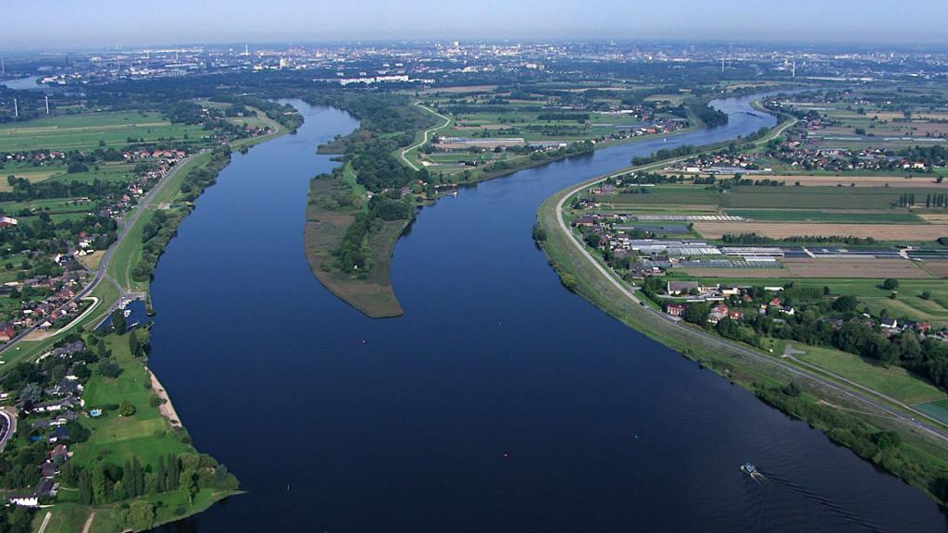
Access to Justice in the Field of Water Law Dr. Moritz Reese, Department for Environmental and Planning Law, Helmholtz Centre for Environmental Research, Leipzig Halle | 10 September 2012
Overview: How is access to justice important in water law
Focus: The lack of A2J on implementation of the Water Framework Directive
Why this lack of A2J is not in line with the Aarhus Convention
Opening A2J on environmental plans and programs: A breakthrough in Germany as example to follow.
Perspectives and questions to discuss

Slide 2
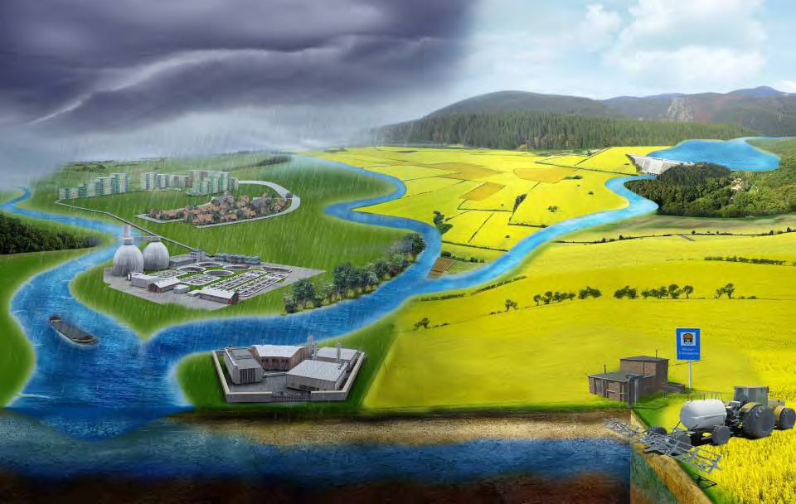
How is A2J important in Water Law – An Overview
Protecting users interests against administrative decisions (permit denial, withdrawl etc.)
Protecting users/riperians against competing uses and downstream effects
Implementing the environmental quality objectives and manage-ment obligations under the WFD

Slide 3
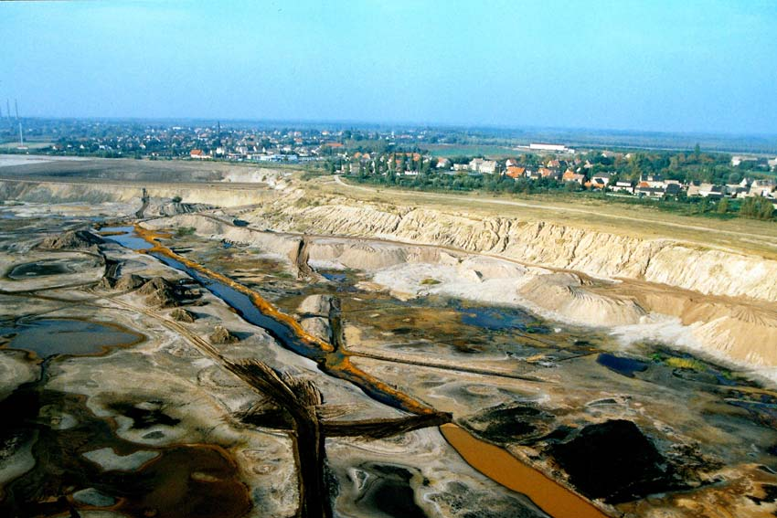
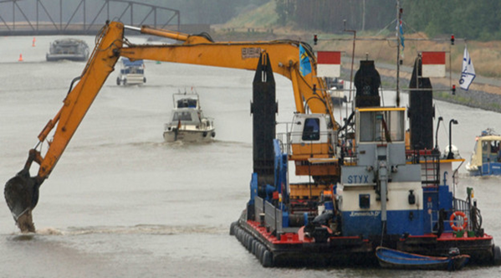
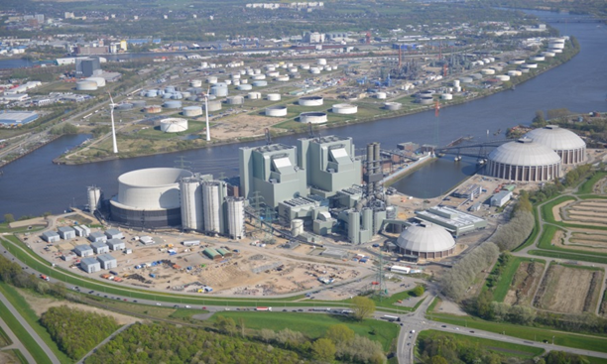
Focus: The lack of A2J regarding implementation of the Water Framework Directive
Environmental objectives and judicial review
No deterioration: new developments must not deteriorate water quality: Exemption regarding new developments/projects subject to overriding public interests (Article 4.7)
NGO standing against relevant projects regularly granted via Article 11 2011/92/EUEIA-Directive
National courts and ECJ have enforced deterioration ban and overruled very wide interpretation in MS practice: Weser-Case C-461/13

Slide 4
Focus: The lack of A2J regarding implementation of the Water Framework Directive
Ecologic objectives and judicial review
Improvement to good ecological and chemical status of natural water bodies and good chemical status and ecological potential of artificial and heavily modified water bodies until 2015.
Programs of Measures to be revised every 6 years
Deadline extension and exemptions in cases of force majeur, technical infeasibility or disproportional cost (Article 4.5)
→State of implementation

Slide 5
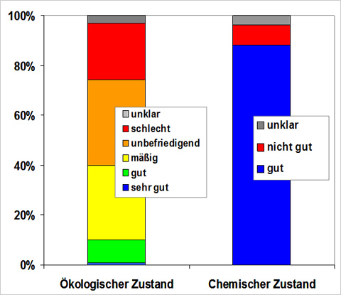
Focus: The lack of A2J regarding implementation of the Water Framework Directive Implementation of WFD quality objectives
Huge implementation deficits accross EU
Germany: only 18% of surface waters and 64% of ground water bodies in good status
Deadline extension 80%, of SWBs and 32% GWBs
Movement towards less stringent objectives
New evaluation according to EQS-Directive 2008/105 and 2013/39/EC
Quicksilver100%
PBDE 100%
PFOS 94%
PAH 47%
(% of waterbodies)
Ecol. Status
Chemical Status

Slide 6
Focus: The lack of A2J regarding implementation of the Water Framework Directive
Reasons for implementation deficit, i.a.
Uncertainty and long term effects of ecol. restoration
Lack of funds & administrative capacities,
Lack of adequate responsibilities and competences,
Lacking willigness to compel land-owners & local actors / only „voluntary“ measures
Measures not adequately derived from objectives
Lack of upstream cooperation
WFD objectives interpreted very weakly or tacitly disregarded ; questionable use of exemptions
So far no (access to) judicial review regarding WFD POMs and exemptions

Slide 7
Focus: The lack of A2J regarding implementation of the Water Framework Directive
Longstanding reluctance to enable jud. review of objective norms „only“ serving general interest
Individual A2J limited to legally protected individual interests („protective rights“ doctrine)
CJEU C-237/07 – Janecek: Individuals can claim adequat PoMs as far as the PoM is protecting their individual interest (health)
NGOs A2J limited to cases regulated in EU and national law (projects with EIA, DE: some decisions in Nature conservation)
German Fed.Ad.Court (5.9.2013): NGO standing against plans and PoMs also only as far as indiviual rights are protected
Water quality objectives do not protect individual interests
Survey: No NGO suit against deficient RBMPs/PoMs detected in Europe, no explicit NGO standing against PoMs reported

Slide 8
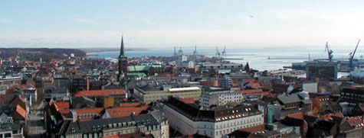
Why this lack of A2J regarding ecologic objectives and management is not in line with the Aarhus Convention
Art 9.3 Aarhus Convention
In addition and without prejudice to the review procedures referred to in paragraphs 1 and 2 above, each Party shall ensure that, where they meet the criteria, if any, laid down in its national law, members of the public have access to administrative or judicial procedures to challenge acts and omissions by private persons and public authorities which contravene provisions of its national law relating to the environment.
Notes:
ACCC/2010/50 Chzech Republic: „it is evident that in cases of land-use planning, if an authority has issued a land-use plan in contravention of urban and land-planning standards or other environmental protection laws, a considerable portion of the public, including NGOs, cannot challenge this act of the authority. The Committee finds that such a situation is not in compliance with article 9, paragraph 3, of the Convention.”

Slide 9
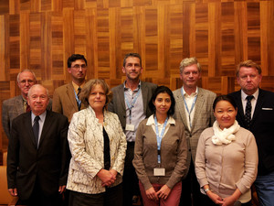
Why this lack of A2J regarding ecologic objectives and management is not in line with the Aarhus Convention
Decision practice of ACCC
C/2005/11 (Belgium): „plan de secteur“: preparatory spatial plans subject to Art. 9.3
C/2010/50 Czech Republic: land use plans subject to 9.3 AC
C/2011/58 (Bulgaria): NGO A2J against general spatial plans required by 9.3 AC
AC Decision V/9h on compliance by Germany of 30.7.2014:
“By not ensuring the standing of environmental NGOs in many of its sectoral laws to challenge acts or omissions of public authorities or private persons which contravene provisions of national law relating to the environment, the Party concerned fails to comply with article 9, paragraph 3, of the Convention;”
Notes:
ACCC/2010/50 Chzech Republic: „it is evident that in cases of land-use planning, if an authority has issued a land-use plan in contravention of urban and land-planning standards or other environmental protection laws, a considerable portion of the public, including NGOs, cannot challenge this act of the authority. The Committee finds that such a situation is not in compliance with article 9, paragraph 3, of the Convention.”

Slide 10
Why this lack of A2J regarding ecologic objectives and management is not in line with the Aarhus Convention
Will the Brown Bear help to bring Aarhus Convention to the water?
C-240/09 – Slovakian Bear: National courts to apply AC in implementing EU environmental law
DE: So far not effectively implemented by German courts
Limited to interpretation of national law, does not entitle courts to set aside existing law.

Slide 11
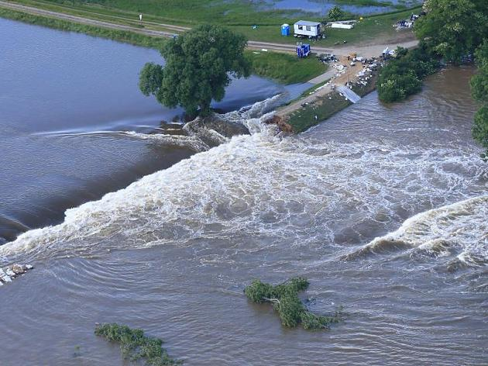
Opening A2J on env. plans and programs: A revolutionary breakthrough in Germany as example to follow.
Draft Bill of the Federal Government Alining the Law on Judicial Review in Environmental Matters (Umwelt-Rechtsbehelfsgesetz) and other Acts to International and EU law (of June 2016):
NGOs shall have standing with regard to obligatory plans and projects that are provided by the law and are subject to mandatory EIA.
Notes:
„Änderungsbedarf ergibt sich zudem aus dem Beschluss V/9h der Vertragsstaatenkonferenz, weil es einer vollständigen Umsetzung von Artikel 9 Absatz 3 der Aarhus-Konvention im deutschen Recht bedarf. Hierzu wird der Anwendungsbereich in § 1 Absatz 1 Satz 1 UmwRG gemäß den Vorgaben der 5. Vertragsstaatenkonferenz der Aarhus-Konvention um die neuen Nummern 4 bis 6 erweitert, um zukünftig die Anwendung umweltbezogener Bestimmungen durch Privatpersonen und Behördenüberprüfbar zu machen. Die Möglichkeit einer umweltrechtlichen Verbandsklage wird damit auf Entscheidungen über die Annahme von Plänen und Programmen ausgedehnt, bei denen eine Pflicht zurDurchführung einer Strategischen Umweltprüfung bestehen kann.

Slide 12
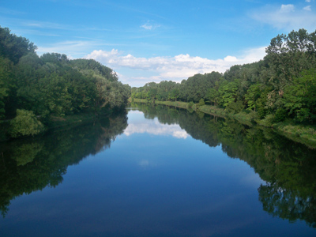
Perspectives, Questions
NGO suits against WFD PoMs
AC-conform development of procedural law
Enforce implementation of EU water law.
Enforce implementation of other quality- and PoM-approaches (marine, flood, waste, noise)
? Do you share the „wide“ interpretation of the ACCC?
? How is the legal situation in your country?
? Do you agree that PoMs should be subject to NGO-suits?
Thank you!

Slide 13
Examples of the Target & Program Approach
NEC-Directive 2001/82/EG: National emission contingents
Air Quality Directive 2008/50/EC: Concentration target values
Water Framework Directive 2000/60/EC: Good water status
Marine Strategy Fr. Directive 2008/56/EC: Good Environmental Status
Waste Framework Directive 2008/98/EC: Recycling targets
Floods Directive 2007/60 - obl. to coordinate ProMs.
Ambient Noise Directive (no explicit EU targets yet, national targets
Many further examples also beyond environmental law!

