Slide 1
Use of bounding conditions envelope concept in the Polish system of environmental impact assessments
Authors:
Mariusz Wójcik, Maciej Stryjecki,
Dominik Gajewski, Paweł Grabowski

Slide 2
Presentation plan
Need for flexibility in EIA
Bounding Conditions Envelope
Foreign and domestic experience with BCE
Methodology principles of EIA using BCE
Legal and procedural aspects in the Polish legal system
BCE and the effective public participation
Challenges in using BCE

Slide 3
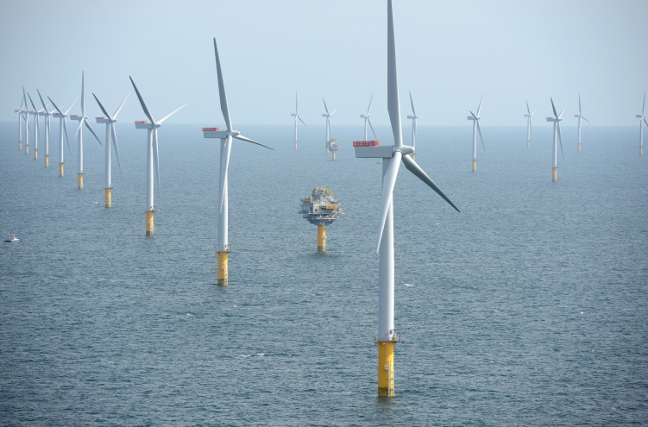
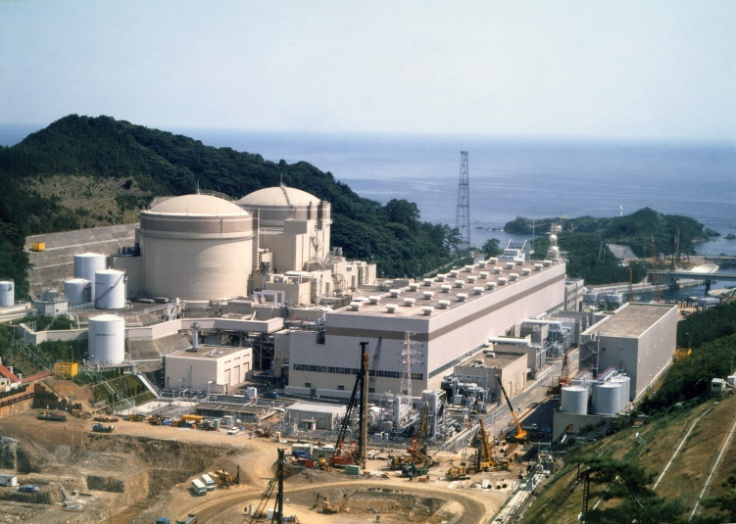
Challenges in the investment process
Long investment development process
Rapid technological development
Uncertainty of final investment parameters
Need for flexible approach in EIA
Challenges:
Procedural – inability to define final investment parameters, especially at the initial stage of the consenting process, especially environmental decision
Economic – final parameters dependent on e.g. technology suppliers, support scheme, mitigation methods etc. which are not defined at the EIA stage
Organizational – need to define and execute environmental surveys without fully defined project parameters
Social – increasing role of public acceptance in the investment process requires effective involvement of stakeholders in the development process
Technological – need to foresee future technological solutions
Offshore wind farm by Statkraft
Ohi Nuclear Power Plant by IAEA Image bank

Slide 4
Bounding conditions envelope (BCE)
Approach where a project in the early stage of the investment process is outlined by its bounding conditions, including clearly defined key parameters and technical solutions (“project envelope”).
BCE:
takes into account that a project evolves over a number of years
forms a framework within which a project must be developed
tool allowing flexible interpretation of the investor’s intentions in the initial stages of the investment while at the same time binding the project development process with the results of the EIA
should be detailed enough to allow assessment of likely environmental impact
should apply the ‚worst case scenario’

Slide 5
Bounding conditions envelope – foreign experience
Country | Project | Use of project envelope | Notes
United Kingdom | Business park in Rochdale | Envelope included an outline application - within 10 years full application had to be made. A condition was specified to prepare a framework document showing the design and layout with plans for phasing different aspects of the development. | Precedence for the use of the project envelope. ‚Rochdale envelope’ named after the case
United Kingdom | Offshore Wind Farms (London Array, Greater Gabbard, Walney, Sheringham Shoal) | Max. parameters and viable options defined: maximum area maximum number , capacity and height of turbines optional foundations alternative cable routes
Czech Republic | Temelin Nuclear Power Plant | Envelope includes 8 reactor technologies | Environmental decision approved in 2013 and siting decision in 2014

Slide 6
Bounding conditions envelope – Polish experience
Offshore wind farm Middle Baltic III
First environmental decision for offshore wind farm in Poland issued (July 2016)
First decision fully based on BCE approach
Key conditions formed in the environmental decision:
Max. number of turbines
Max. turbine height
Max. clearance between turbine rotor and sea surface
4 alternative foundation solutions
Supplementary EIA at the construction permit stage
First Polish Nuclear Power Plan
Scoping decision issued in May 2016
Project information sheet assuming EIA based on BCE and worst case scenario approach
4 alternative reactor technologies considered

Slide 7
Methodological principles of EIAs when using BCE
Identification of key impacts of the project on the environment
Identification of project parameters affecting the scale of impacts (e.g. height, power output, noise emission etc.)
Establishing the BCE (maximum values of the parameters)
Performing EIA for the „worst case scenario” meaning maximum parameters of the BCE
Parameter | Variant A (max. value) | Variant B (max. value)
Total height | 275 m | 212,5 m
Clearance between sea level and rotor | 20 m | 20 m
Rotor diameter | 200 m | 192,5 m
Number of turbines | 120 | 200
Number of substations | 6 | 8
Total area of rotors | 3 768 000 m2 | 5 820 800 m2
Seabed uptake (gravity foundation) | 158 382 m2 | 261 456 m2
Turbine density | 1,35 turbine/km2 | 2,25 turbine/km2
Length of inner array power cables | 200 km | 200 km
Source: EIA Report Middle Baltic III Offshore Wind Farm

Slide 8
Legal and procedural aspects of using BCE in the Polish legal system
Polish legal framework enables the use of BCE through:
Multistage EIA approach (supplementary EIA at the development consent stage)
„EIA ACT”
The act of 3 October 2008 on the Provision of Information on the Environment and its Protection, Public Participation in Environmental Protection and Environmental Impact Assessments (Official Journal of the Laws of 2016, Item 353, as amended)
Article 88
1. The environmental impact assessment for a project within the framework of the procedure to issue the decisions referred to in Article 72 (1) (1), (10), (14) and (18) shall also be conducted:
1) on the request of the entity which plans to undertake the project, submitted to the authority competent to issue the decision;
2) where the authority competent to issue the decision finds that changes have been made to the request for the issue of the decision in relation to the requirements set out in the decision on the environmental conditions;
3) when it is impossible to confirm the installation readiness to capture carbon dioxide while issuing the decision on environmental conditions for fuel combustion installation to generate electricity generation, with a nominal electric power not less than 300 MW.
1a. In case the decision on environmental conditions states the need for conducting a supplementary assessment of the project on the environmental, the entity planning to undertake the project shall submit a report on the impact of projects on the environment.
[…]
SCOPING DECISION
ENVIRONMENTAL DECISION
SUPPLEMENTARY EIA
DEVELOPMENT CONSENT

Slide 9
Legal and procedural aspects of using BCE in the Polish legal system
Polish legal framework enables the use of BCE through:
Multistage EIA approach (supplementary EIA at the development consent stage)
Authority’s flexibility in forming scoping decisions – art. 68 of EIA Act (provisions coming into force in January 2017 will further enhance the use of BCE)
Article 68
In defining the scope of the report, the authority shall take into account the current knowledge and research methods as well as the existing technical possibilities and the availability of data
In defining the scope of the report, the authority may – considering the location, character and magnitude of the environmental impact of the project:
1) resign from the requirements concerning the content of the report referred to in Article 66 (1) (4), (13), (15) and (16); this shall not apply to public roads and railway lines, which are projects which may always have a significant impact on the environment;
2) indicate:
a) the types of alternative options which need to be examined,
b) the types of impacts and the elements of the environment which require detailed analysis,
c) the scope and methods for the assessment.
b) scope and detail of the required data to characterize the project, the types of impacts and the elements of the environment which require detailed analysis,
as of January, 1st 2017

Slide 10
Legal and procedural aspects of using BCE in the Polish legal system
Polish legal framework enables the use of BCE through:
Multistage EIA approach (supplementary EIA at the development consent stage)
Authority’s flexibility in forming scoping decisions – art. 68 of EIA Act (provisions coming into force in January 2017 will further enhance the use of BCE)
The level of detail for project description is not defined in the EIA Act. Information must however enable to perform environmental impact assessment according to the art. 62 of the EIA Act and prepare EIA Report according to the art. 66 of the EIA Act.
Article 62
Within the framework of the environmental impact assessment, the following shall be identified, analysed and assessed:
the direct and indirect effects of a given project on:
the environment, human health and the quality of human life,
property,
cultural heritage,
the interaction between the elements referred to in letters a)–c),
access to mineral deposits;
the possibilities and ways of preventing and reducing the adverse impact of the project on the environment;
the required scope of monitoring.
Within the framework of the assessment of the impact of a project on a Natura 2000 site, the impacts of projects on Natura 2000 sites shall be identified, analysed and assessed, taking also into account the accumulation of the impact of the project with those of other projects.

Slide 11
Legal and procedural aspects of using BCE in the Polish legal system
„EIA ACT” Article 66
1. The environmental impact report for a project shall contain:
1) a description of the proposed project, in particular:
a) the characteristics of the whole project and the conditions of the site use at the stages of construction and operation,
b) the main characteristic features of production processes,
c) the envisaged types and quantities of pollutants caused by the operation of the proposed project;
2) a description of the natural elements of the environment exposed to the envisaged environmental impact of the proposed project, including the natural elements protected pursuant to the Nature Conservation Act of 16 April 2004 […];
3) a description of cultural heritage sites, protected pursuant to the regulations in the protection and care of cultural heritage sites, existing in the vicinity or within the direct range of the impact of the proposed project;
3a) a description of the landscape, in which the project is to be located;
4) a description of the envisaged effects on the environment in the case where the project is not undertaken;
5) a description of the options analysed, including:
a) the option proposed by the proponent and a reasonable alternative,
b) the option which is most favourable for the environment, along with reasons for their choice;
6) the determination of the expected environmental impacts of the options analysed, also including the impact in the event of a major industrial accident as well as the possible transboundary impact on the environment, […];
7) the justification for the option proposed by the proponent, indicating its impact on the environment, in particular on:
a) human beings, fauna, flora, fungi, natural habitats, water and air,
b) the land surface, including land mass movements, climate and landscape,
c) property,
d) the cultural heritage sites and landscapes covered by the existing documentation, in particular those included in the register or records of cultural heritage sites,
da) landscape
e) the interactions between the elements referred to in letters a)–d);
f) safety of road traffic in case of a road within a trans-European road network;
8) a description of the prediction methods applied by the proponent and a description of the expected significant environmental effects of the proposed project, including direct, indirect, secondary, cumulative, short-term, medium‑term and long-term, permanent and temporary environmental effects caused by:
a) the existence of the project,
b) the use of environmental resources,
c) emissions;
[…]

Slide 12
Legal and procedural aspects of using BCE in the Polish legal system
Decision on the environmental conditions - procedure
Identification of viable options and framework for the BCE
Project information sheet (PIS) describing the foreseen BCE and rational alternatives allowing for identification of key impacts.
Submission of PIS, although facultative in case of projects that could potentially have a significant impact on the environment is highly recommended when using BCE.
Screening and scoping
Environmental surveys
Scope and range of surveys should assume „worst case scenario”
EIA Report
Clear definition of project bounding parameters and worst case scenarios,
Clear distinction between BCE and rational alternatives
Clear description of planned technology under BCE
Public involvement
Using BCE cannot be an excuse to provide insufficient detail for effective involvement in the decision-making process.
Environmental decision
Environmental decision should include bounding conditions for future decisions.
Conclusion on the need for supplementary EIA at a later stage
Development consent
Supplementary EIA is likely to be imposed by the authority. The goal is to verify the initial EIA against the final design

Slide 13
Administrative tools for verification of the environmental impacts of projects based on BCE
Final project design
Development consent (construction permit)
Construction
Operation
Project concept
Project development
EIA and the environmental decision
Environmental monitoring
and post-construction environmental analysis
Obligation to meet conditions set in environmental decision
Supplementary EIA
Environmental monitoring
PUBLIC PARTICIPATION

Slide 14
Exemplary conditions set in the environmental decision
Obligations in environmental decision for offshore wind farm Middle Baltic III
Obligations to be included in the construction design:
design max. 120 turbines with minimum clearance between rotor and sea level of 20 m, rotor diameter max. 200 m and max. height of 275 m
design max. 6 substations at sea and max. 200 km of inner array power cables
max. density of wind turbines of 1,35 turbines/km²
choose and provide justification for the choice of foundations from the following options: monopile, gravitational, jacket, tripod foundations.
Design and implement technical solutions in the form of bubble curtains or other technology, to minimize the impact of underwater noise on fish and marine mammals, guaranteeing reduction of noise at the nearest border of the Natura 2000 area (protecting marine mammals) to the level below 171 dB re 1 $µ$Pa2·s.
Reassess the impact on the environment within the administrative procedure for issuing of a construction permit (Supplementary EIA)
Monitor the impact on the environment during construction, operation and decommissioning of the farm according to scope, schedule and methodology set in the decision
Execute and submit to the Regional Directorate for Environmental Protection in Gdańsk a post-construction analysis,

Slide 15
BCE and the effective public participation
Using BCE may create favourable conditions for effective public participation - possibility to adjust the project design at the initial stage of development within the BCE
Challenges in using BCE:
may create confusion among the public due to lack of final solutions
conservative approach may create a distorted perception of the project among the public (overly negative)
conservative approach may also lead to negative environmental decision due to significant cumulative impacts (e.g. in case of several projects using BCE in the vicinity)
overly flexible project description may result in rejection from the authorities due to insufficient information about the project

Slide 16
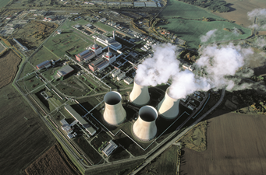
BCE and the effective public participation – case study
TEMELIN NULCEAR POWER PLANT (NPP)– CASE STUDY
NPP project located in Temelin Czech Republic
Project assuming envelope of several reactor technologies
EIA procedure including transboundary procedure ended in 2013 with an environmental decision issued
Allegations were made that the investor did not guarantee effective participation of the public in Germany
The case is currently being reviewed by Aarhus Convention Compliance Committee. Draft findings of the committee are available.
Among other allegations several dealt with the use of ‚envelope’ approach - „public was not able to verify whether the potential environmental effects of each design fell within the legally set criteria for safety, severe accidents and potential emissions or assess their potential environmental impacts.” (non-compliance with article 6, paragraph 6 (a) and (c) of Aarhus Convention.
Conclusions:
Public participation must be guaranteed at a stage of the decision making at which the exact designs or technical specifications (including risk factors and potential environmental impacts) are under consideration.
Sufficient technical specification should be provided to guarantee effective public participation when all options are open.
Nuclear Power Plant in Temelin (existing reactors 1 & 2)

Slide 17
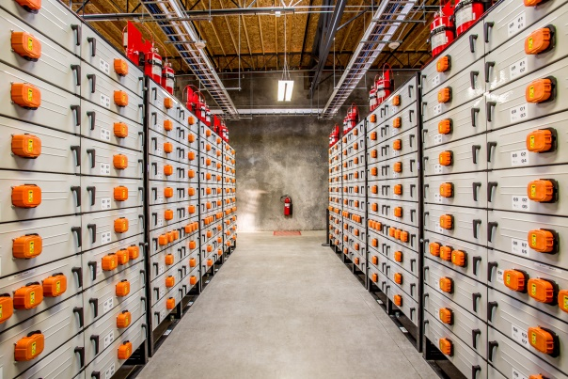
Potential use of BCE in Poland
Offshore wind farms – rapid technological advancement, long project development
Nuclear power plant – long project development, complicated and multi-stage technology supplier selection process
Carbon capture and storage projects– pioneering nature, lack of established exemplary investments
Utility scale energy storage systems – rapid technological advancement
Electro-mobility - rapid technological advancement
Offshore wind farm by Statkraft
Ohi Nuclear Power Plant by IAEA Imagebank
Energy Storage System by Portland General Electric

Slide 18
Summary
Polish legal system enables procedural and legal effectiveness of EIAs for projects based on the BCE approach
BCE is applicable to complicated projects with long development process and rapid technological development, when final solutions cannot be identified at the initial stage
BCE allows for flexible project development while at same time enabling EIA process
BCE enables more effective public involvement provided proper description of the project

Slide 19
Summary
Polish legal system enables procedural and legal effectiveness of EIAs for projects based on the BCE approach
BCE is applicable to complicated projects with long development process and rapid technological development, when final solutions cannot be identified at the initial stage
BCE allows for flexible project development while at same time enabling EIA process
BCE enables more effective public involvement provided proper description of the project

Slide 20
Thank you for listening!
Mariusz Wójcik
E-mail: mw@n-pro.pl
Tel. +48 514 997 337

